Slide 1
MDA710/720 Machine learning and Big data analytics in business Final Project
Prof. Han
By Elle Larijani

Slide 2
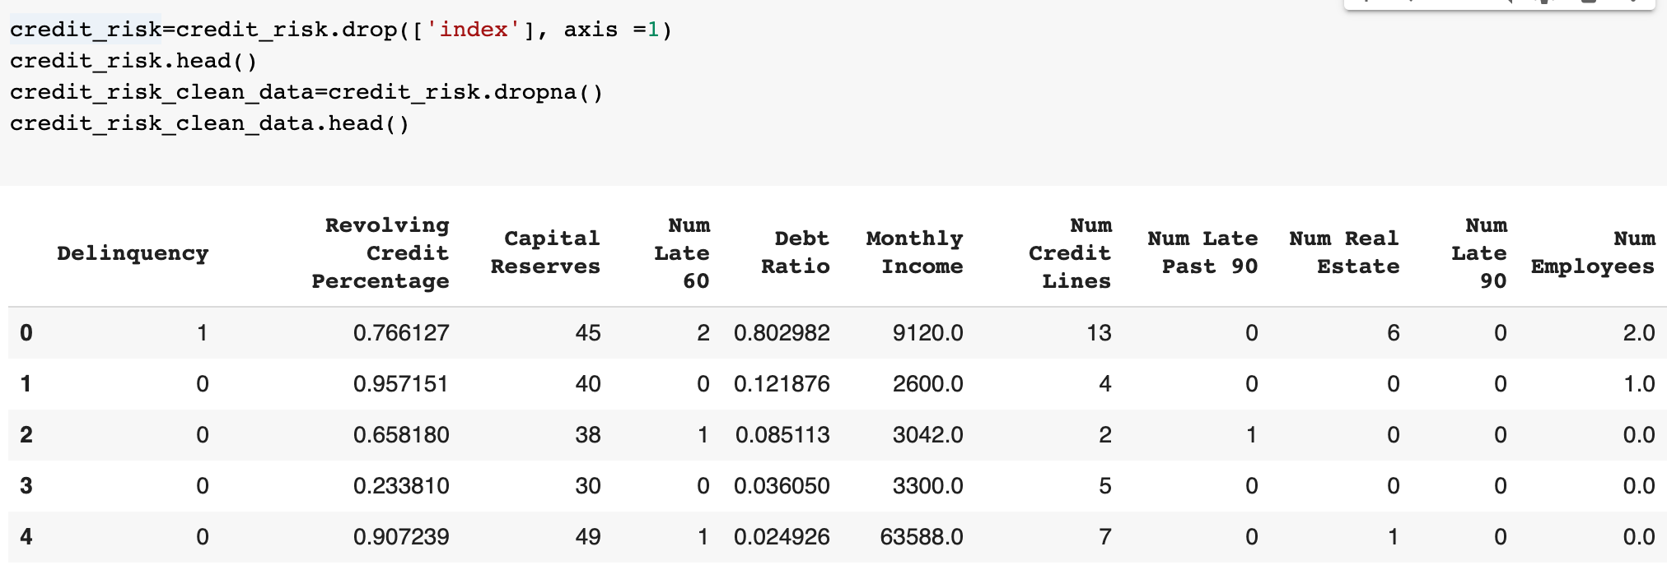
Clean your data first by removing missing data and save it as credit_risk_clean_data.csv

Slide 3
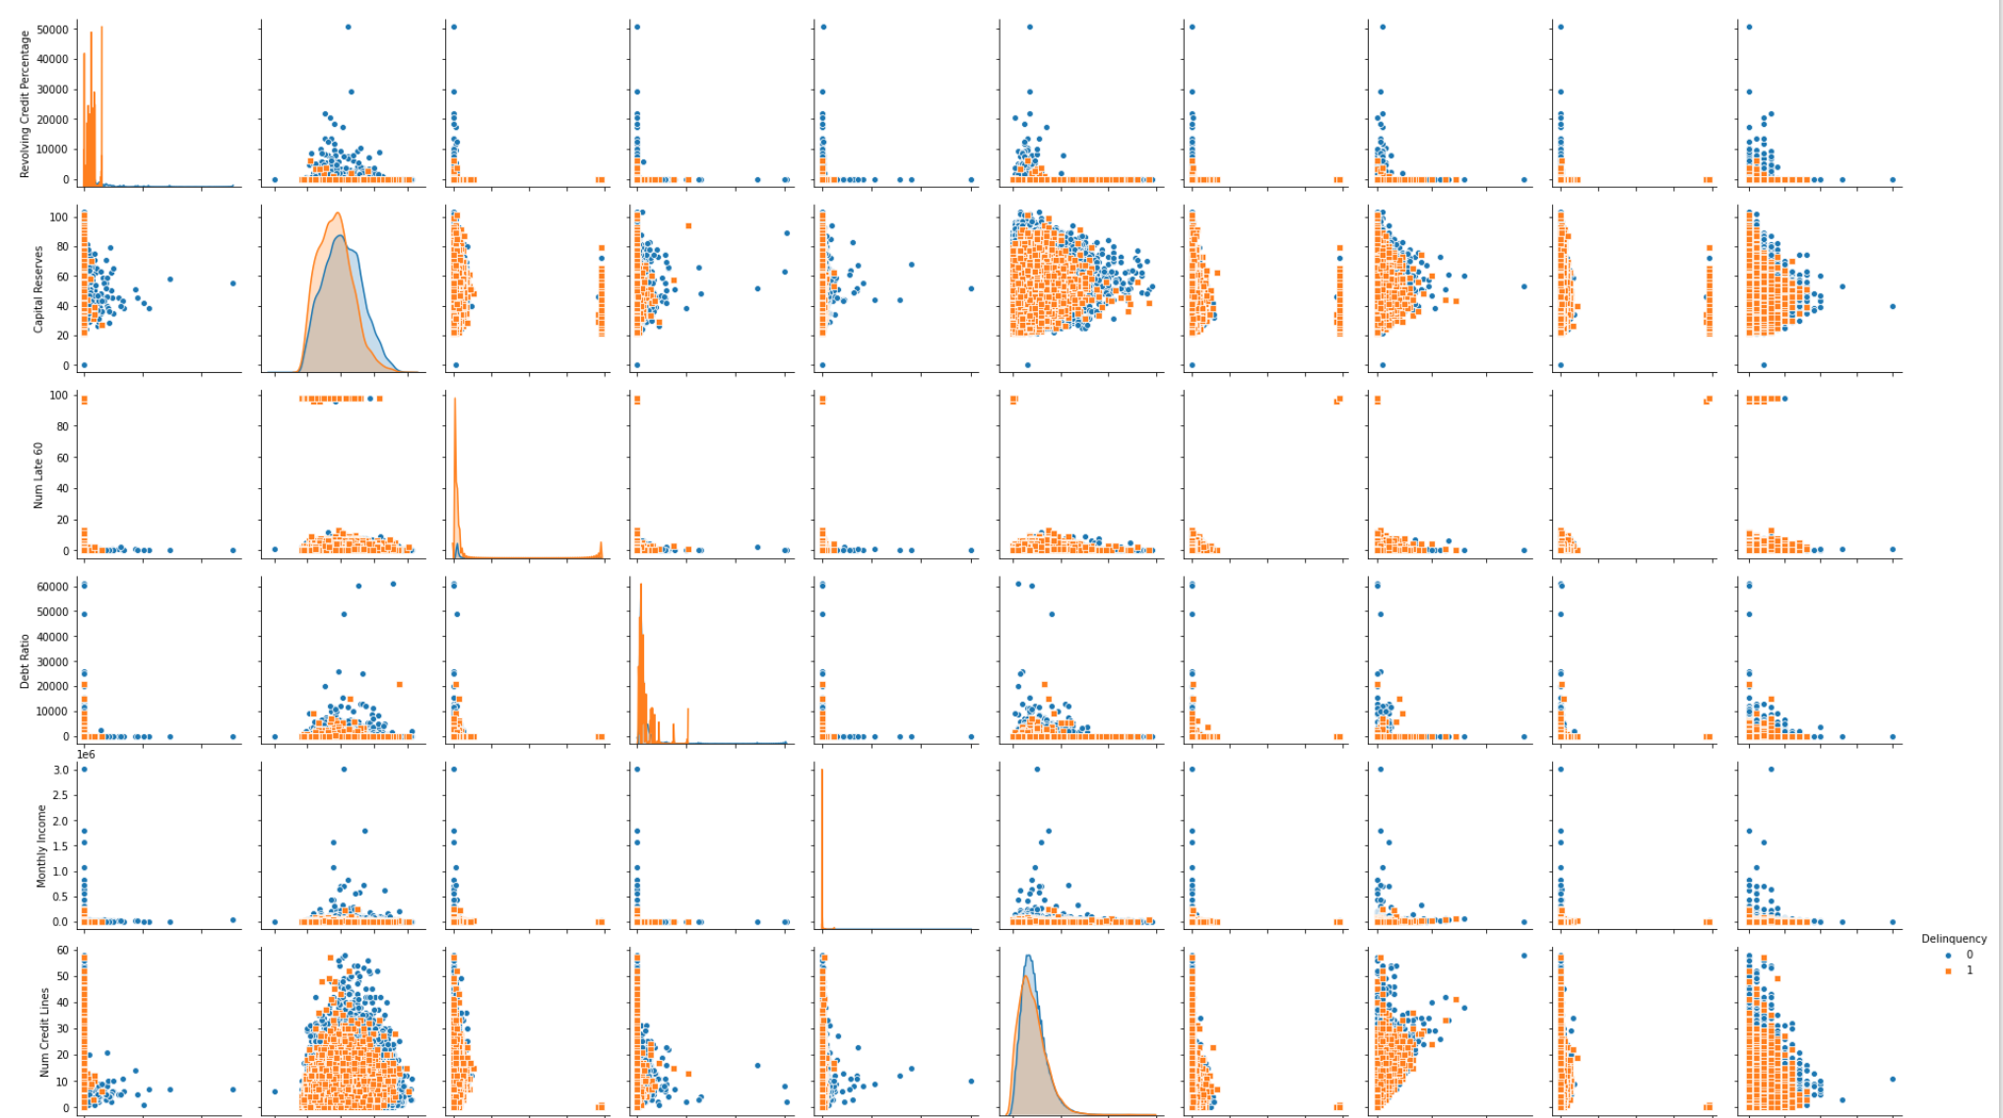
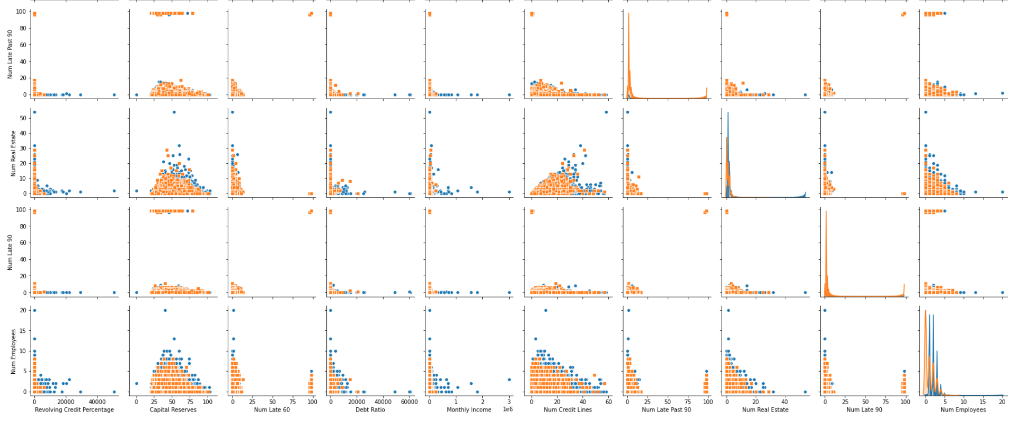
Visualize credit_risk_clean_data

Slide 4

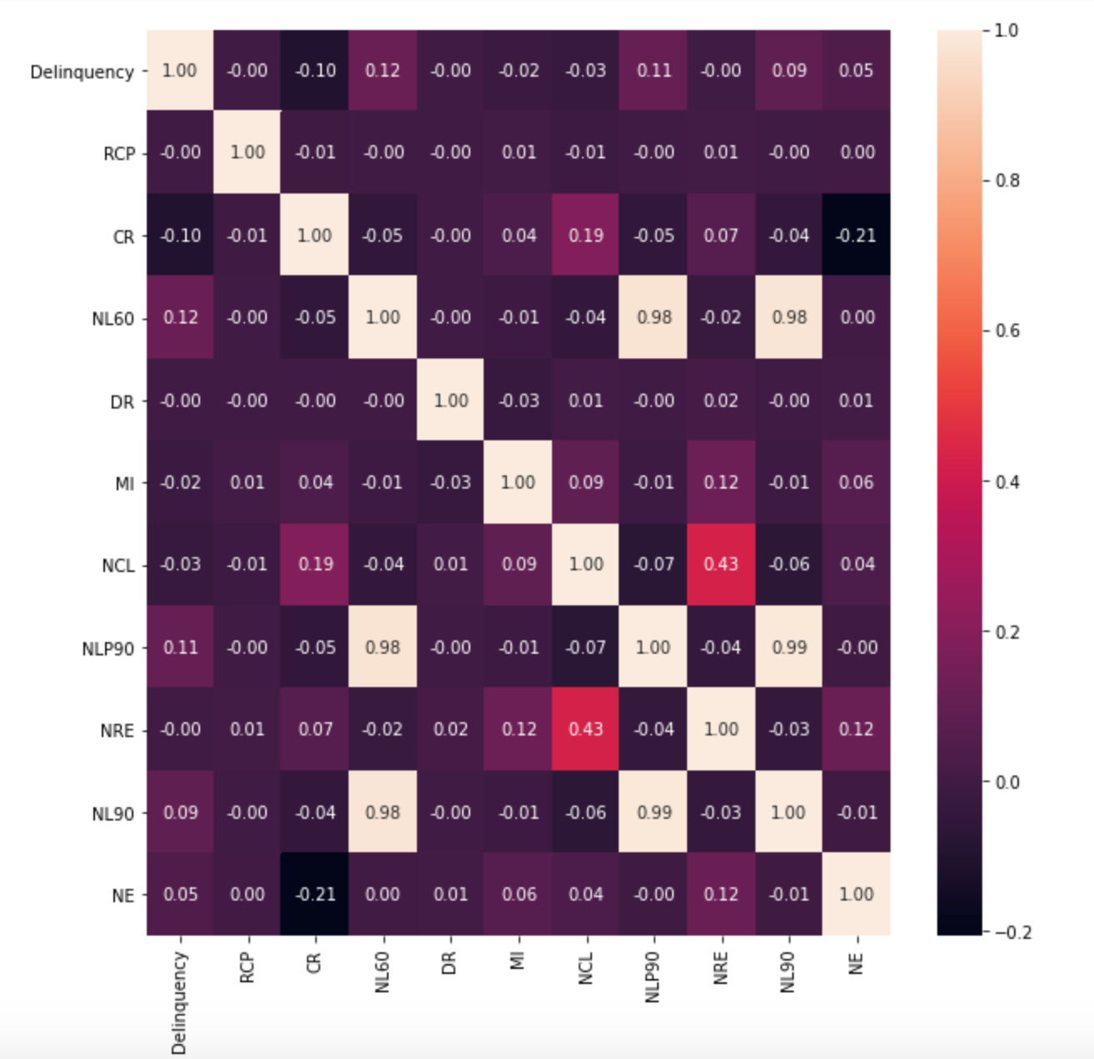
Correlation credit_risk_clean_data features

Slide 5
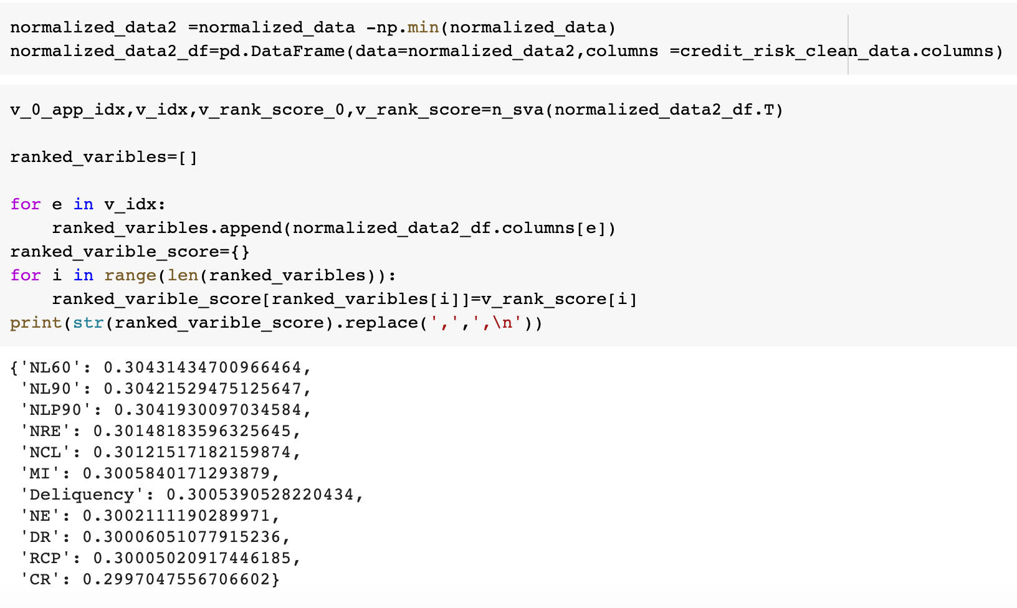
Rank variable importance by using nonnegative singular value approximation (SVA)

Slide 6
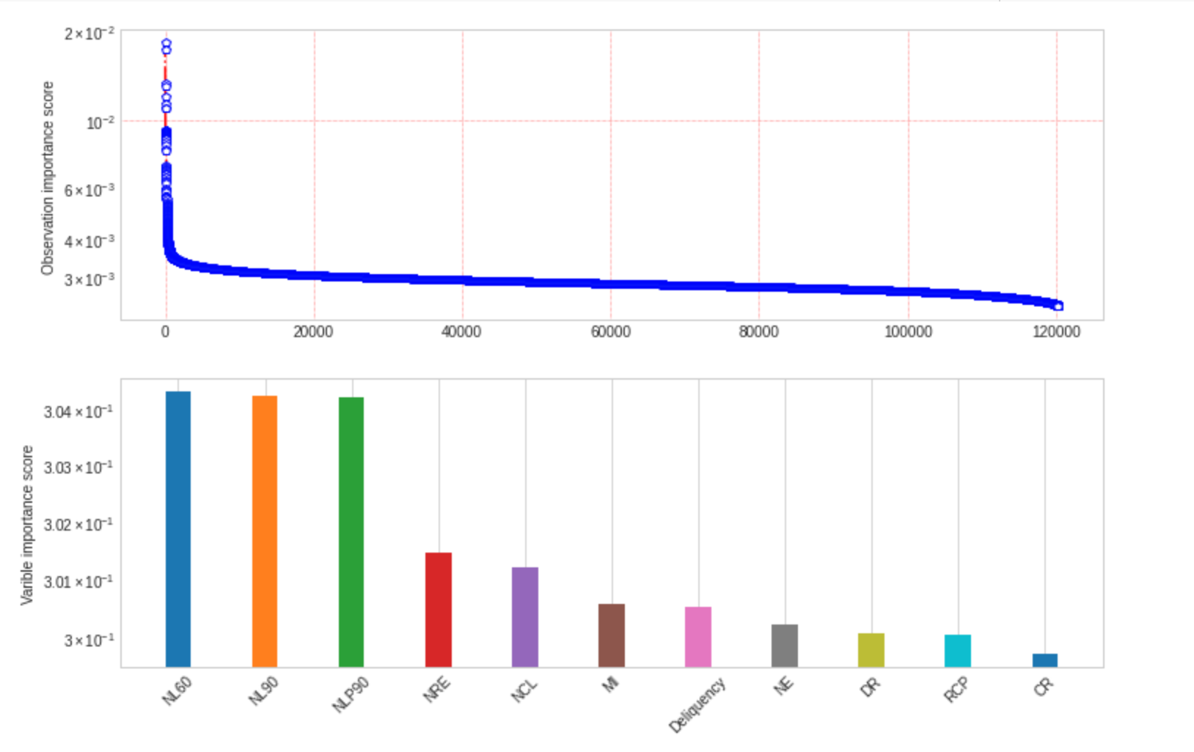
Visualizing the importance score

Slide 7
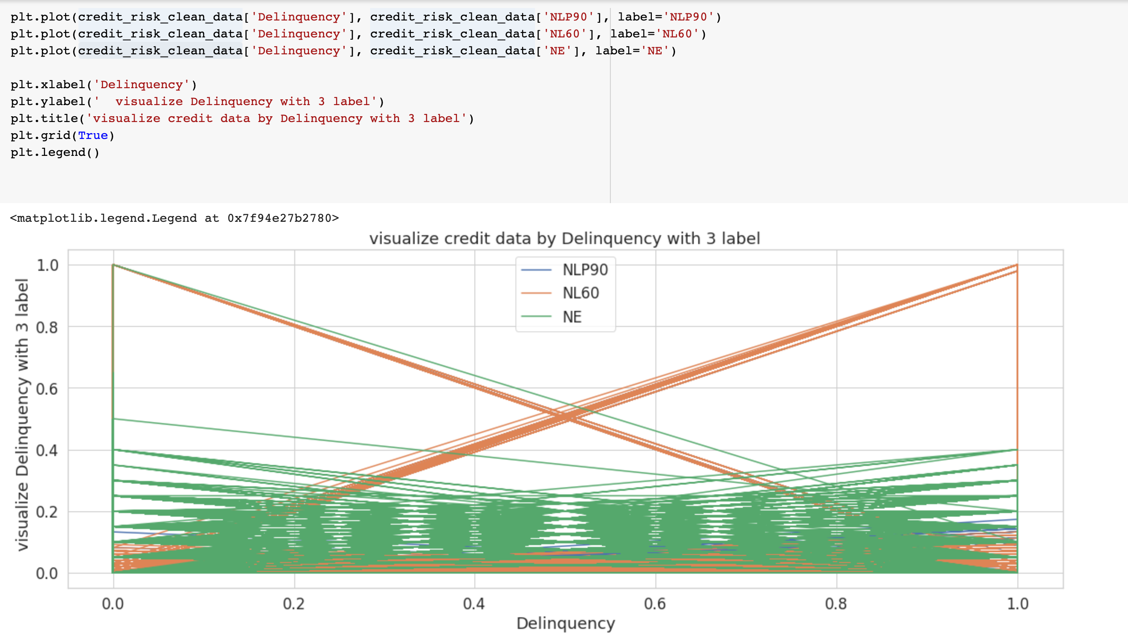
Visualizing credit data set by delinquency with 3 lables

Slide 8
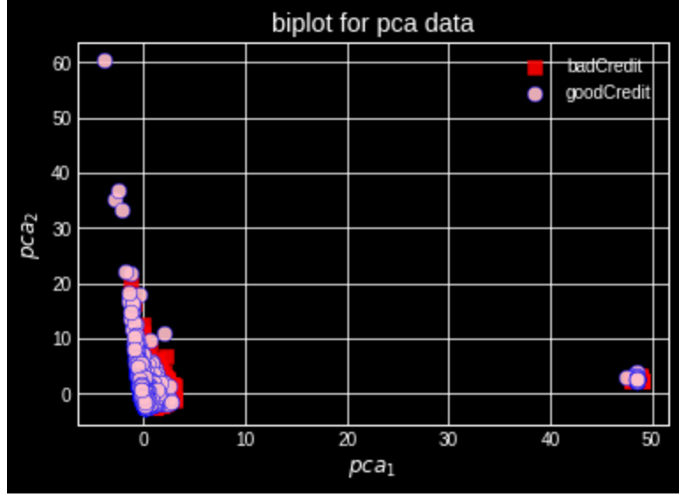
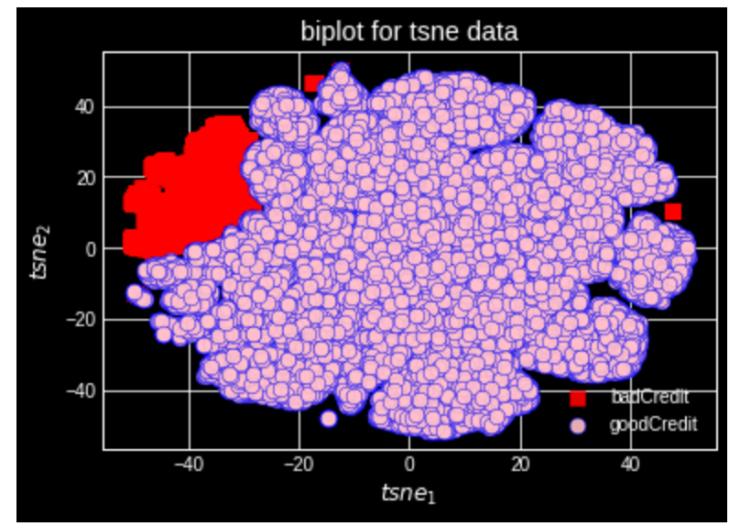
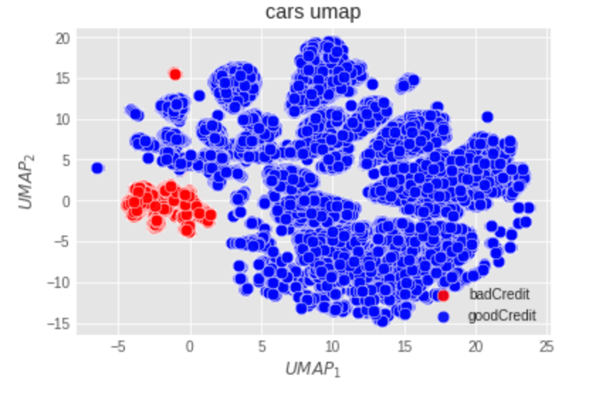

Visualize the dataset via PCA, t-SNE, and UMAP By considering delinquency as 1 & 0
badCredit=credit_risk_clean_data['Deliquency']==1
goodCredit=credit_risk_clean_data['Deliquency']==0

Slide 9
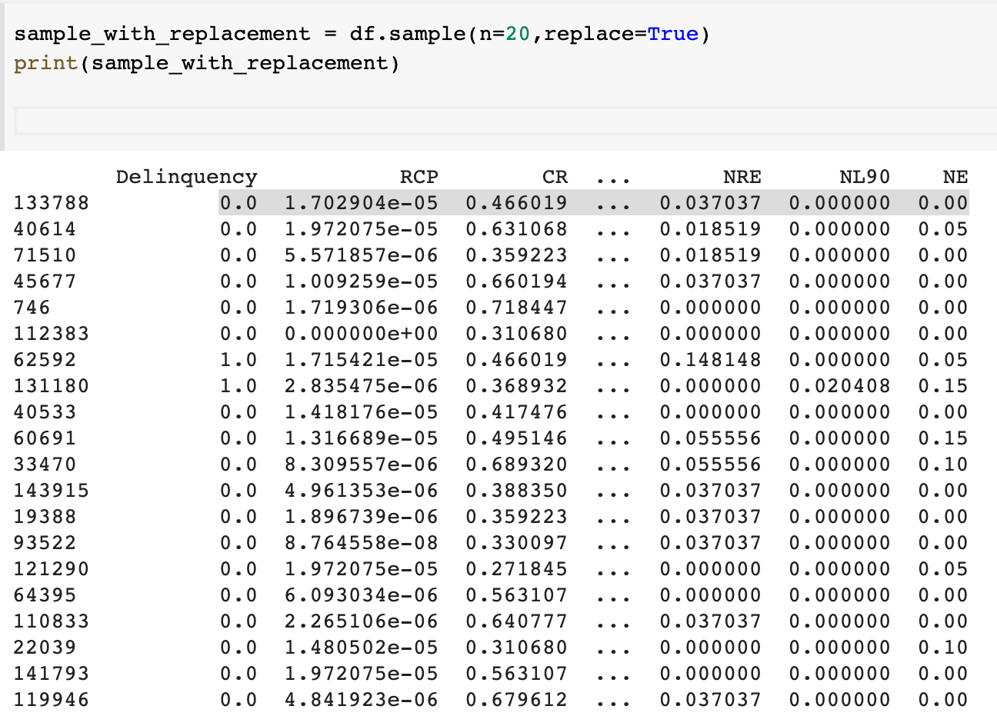
Randomly selected 20 points and find its 10 nearest neighbors for each one

Slide 10
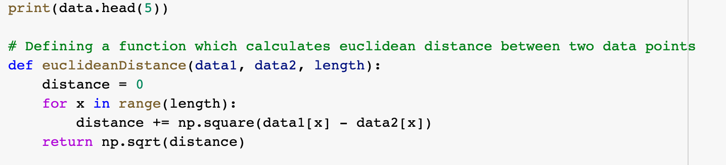
Defining a function which calculate Euclidean distance between 2 data points To get the 10 neighbors

Slide 11
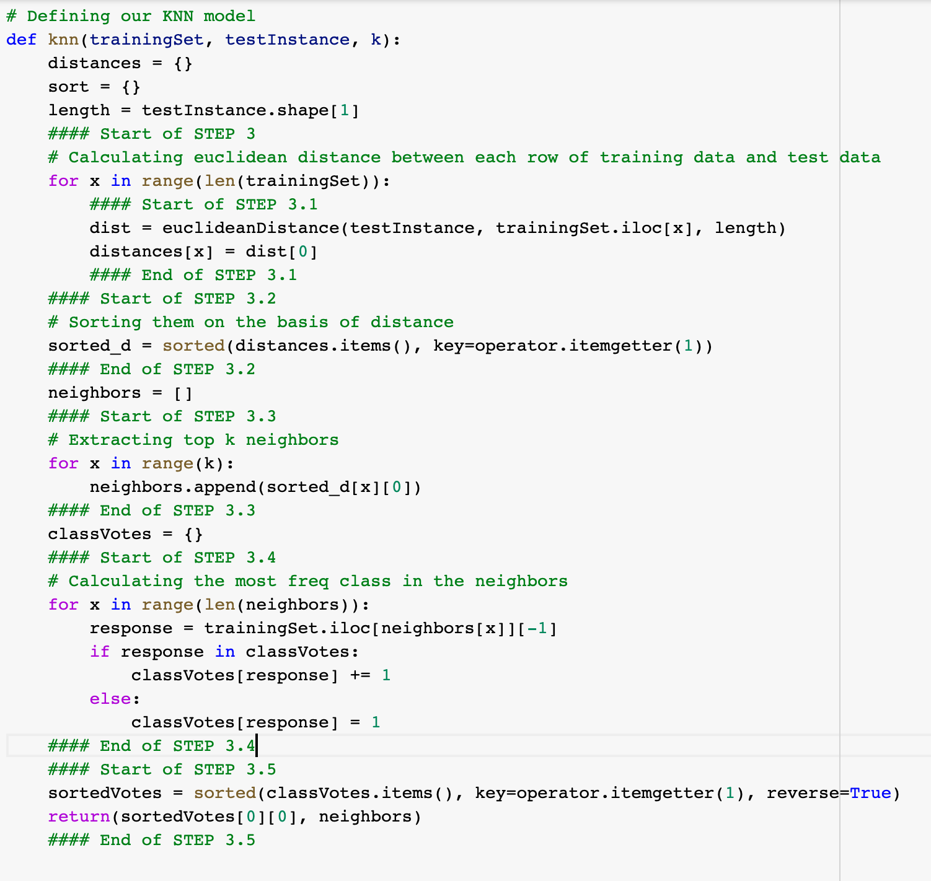
Defining our knn model

Slide 12
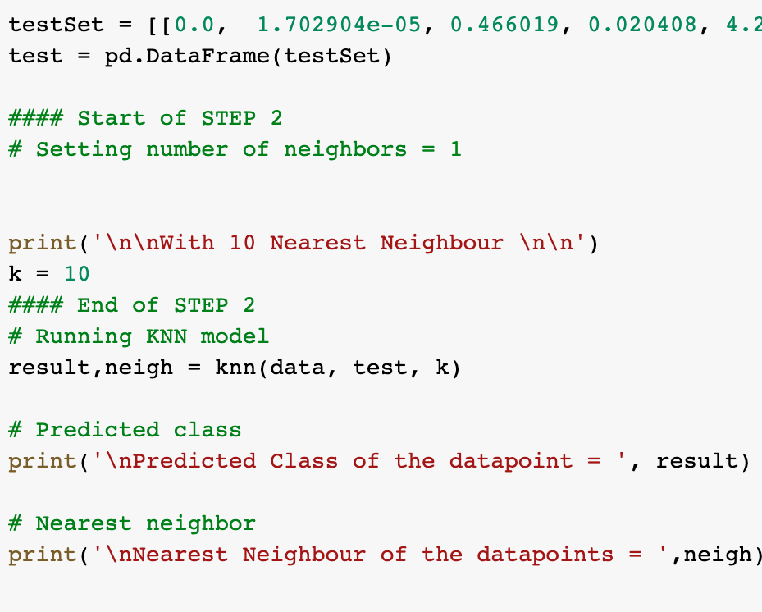
Getting the 10 neighbors for the first sample

Slide 13
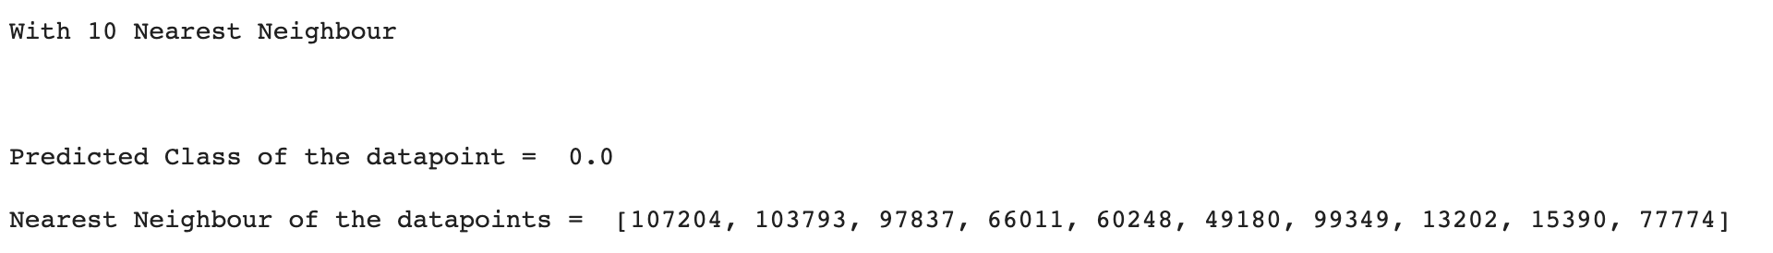
10 neighbors of the First row of 20 sample points

Slide 14
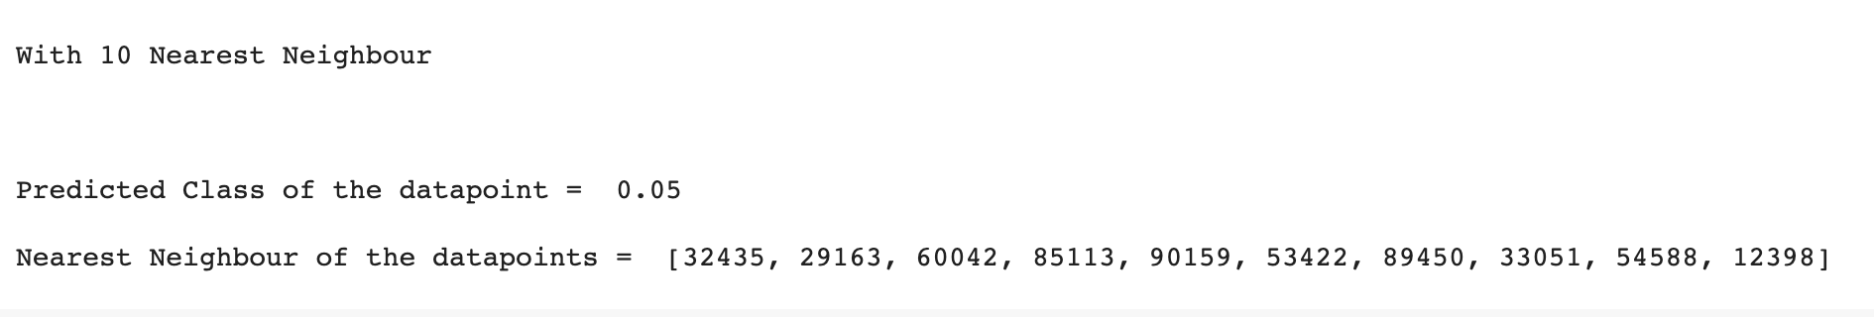
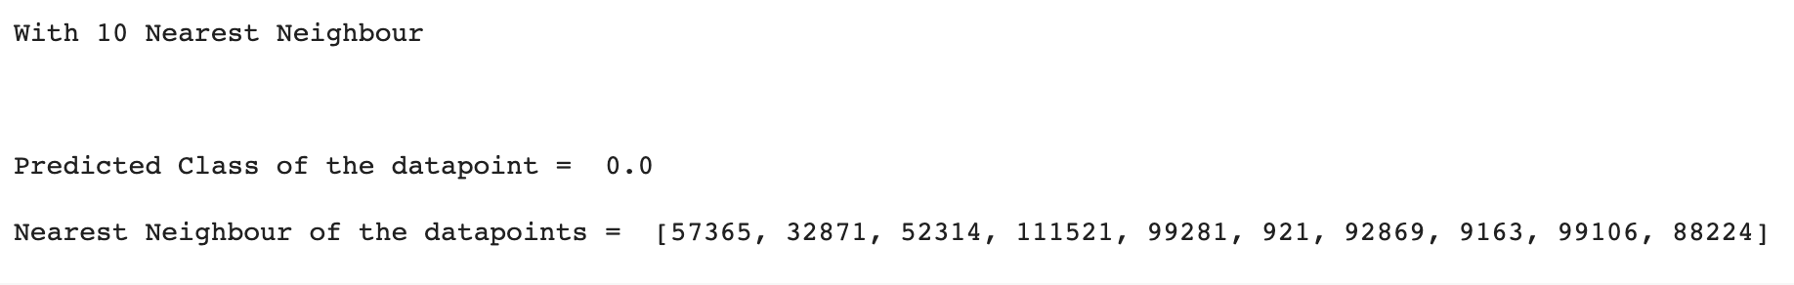
Second and 3rd point of sample

Slide 15
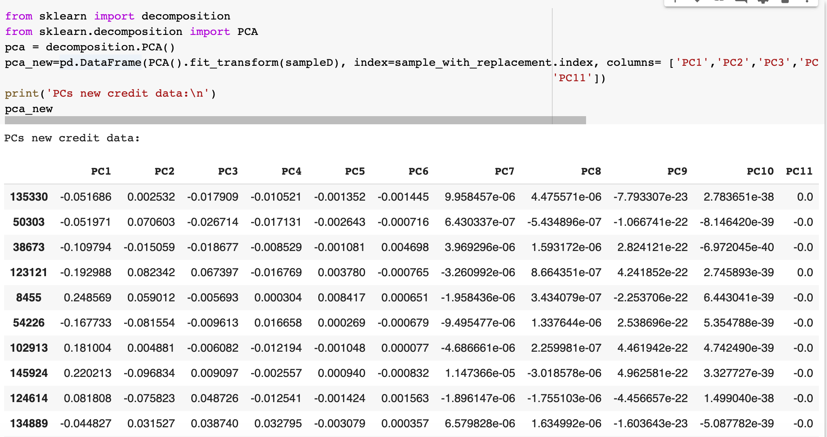
Find the corresponding embedding point for each point in PCA for 11 lables

Slide 16
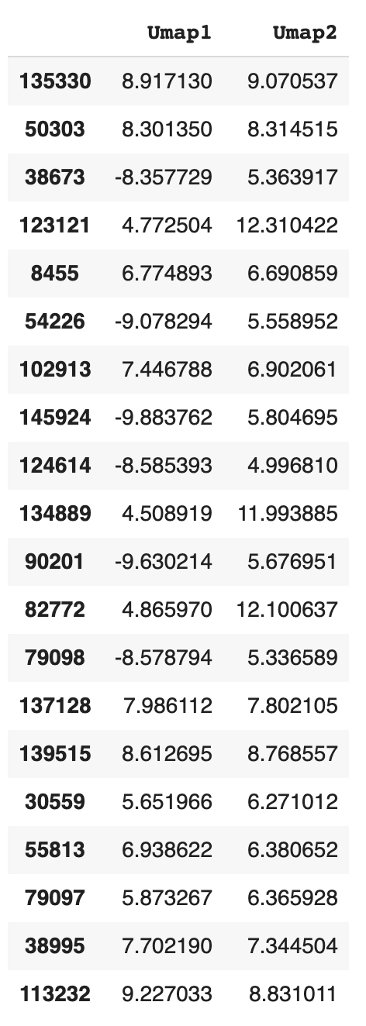
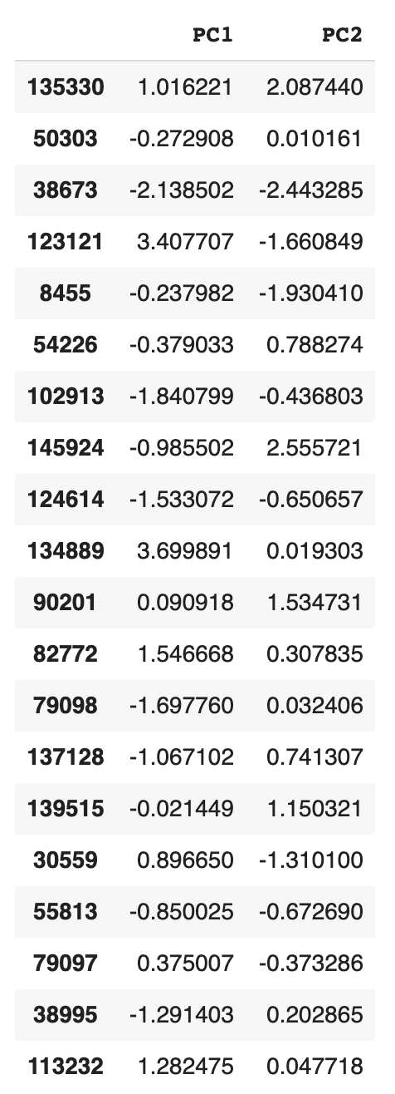
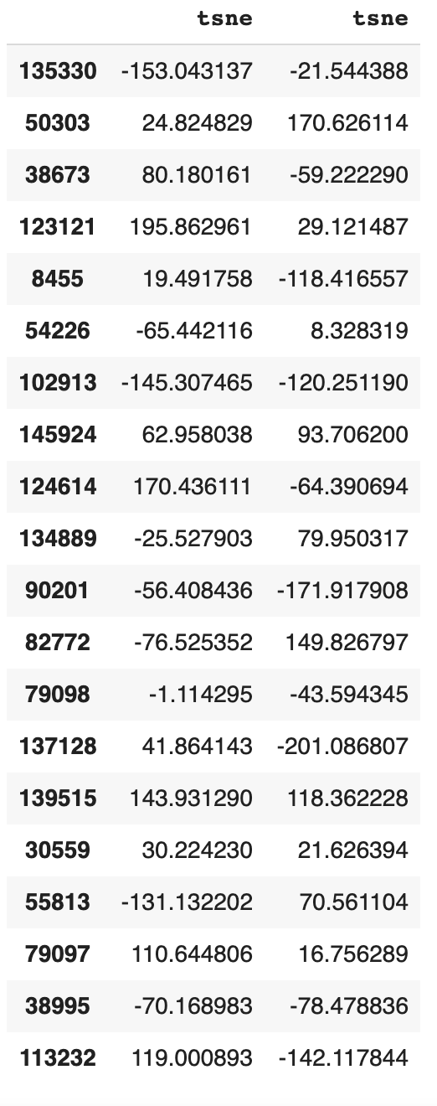
comparing the corresponding embedding point for each point in PCA, t- SNE, and UMAP

Slide 17
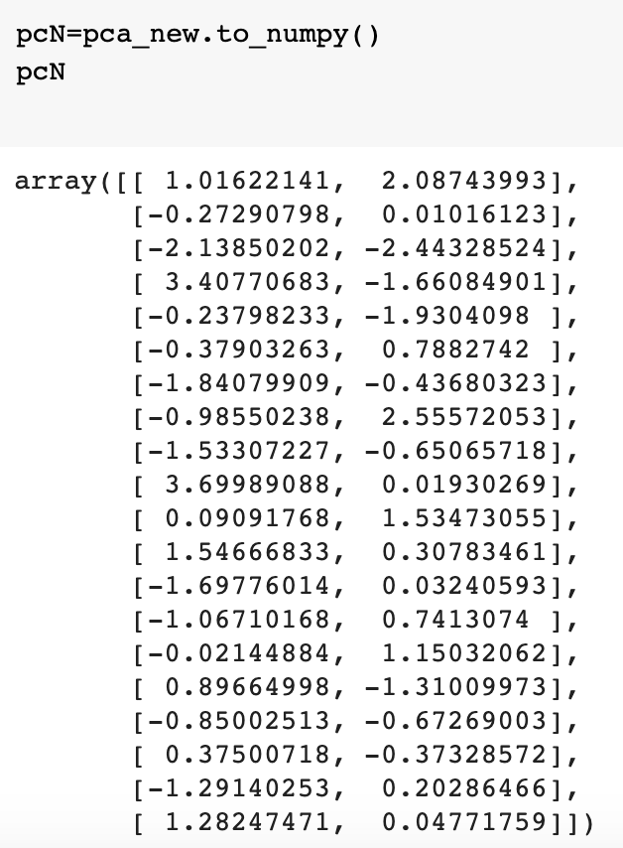
Calculate the 10 nearest neighbors for each one embedding pca point
First, we should convert the pca dataframe to an array
Second, using the same definision for getting the 10 neighbors

Slide 18
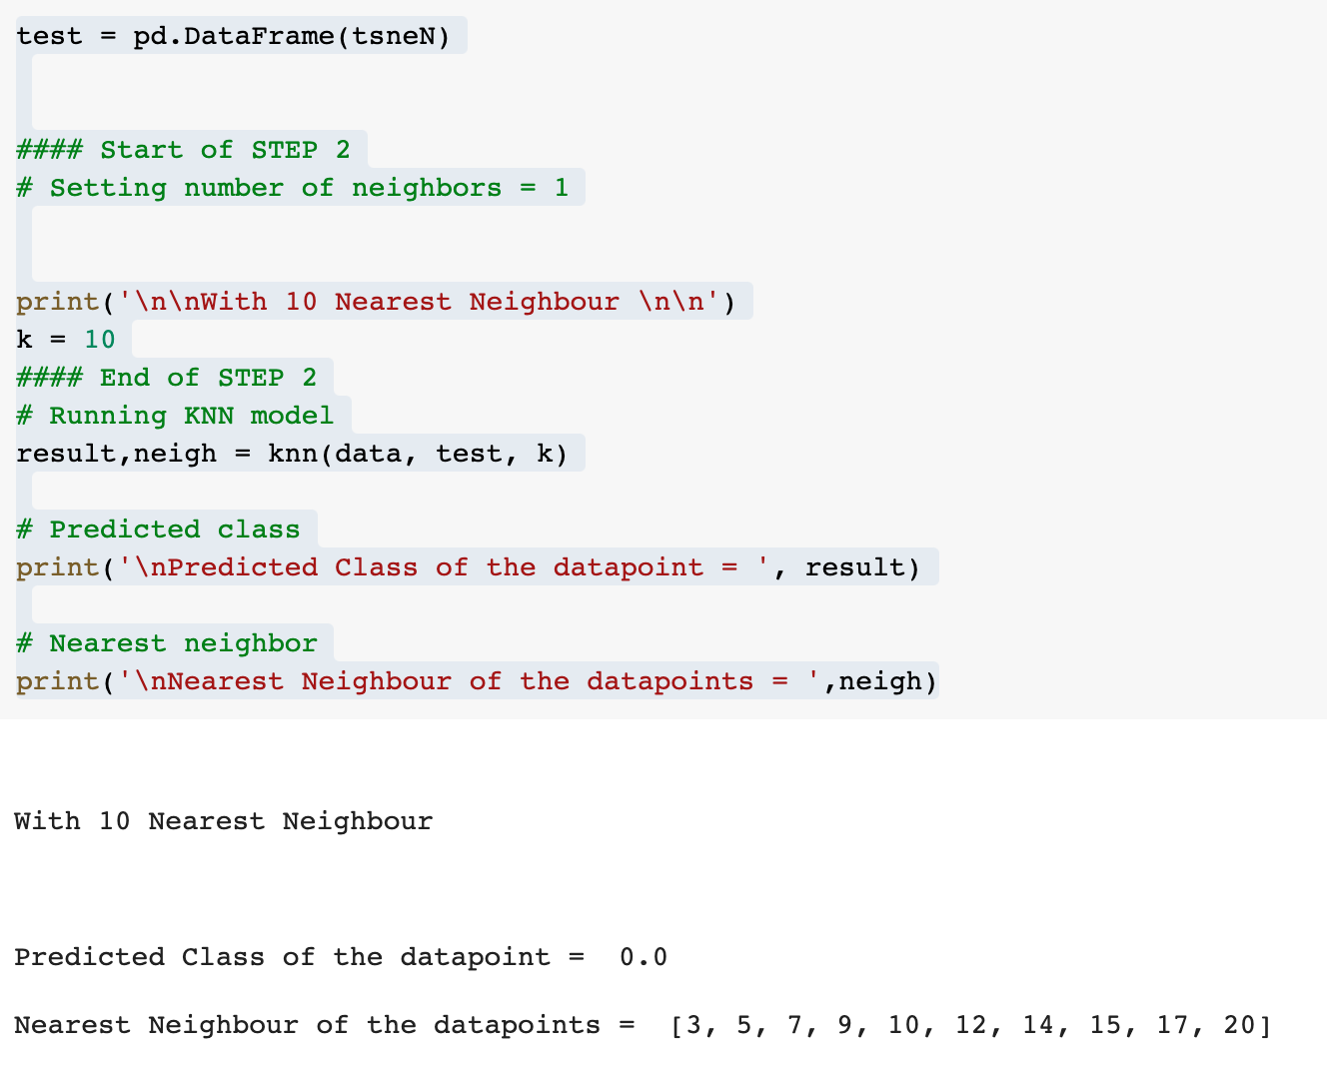
Calculate the 10 nearest neighbors for each one embedding tsne point

Slide 19
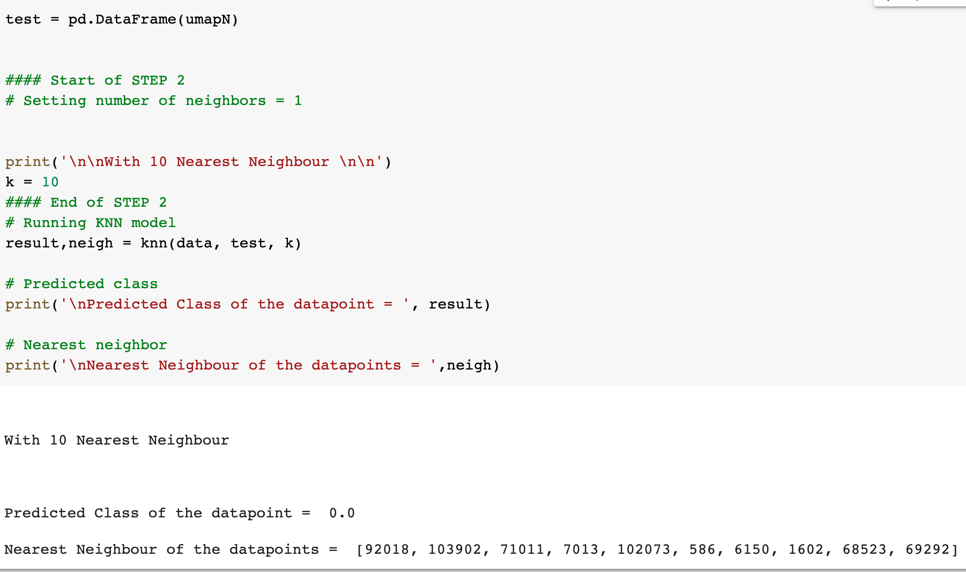
Calculate the 10 nearest neighbors for each one embedding umap point

Slide 20
Compare the nearest neighbors for each point in the original space and embedding space. Which method has the most repeatable neighbors in the embedding space?
PCA
TSNE
UMAP
WE DON’T HAVE repeatable neighbors in embedding spaces!

Slide 21
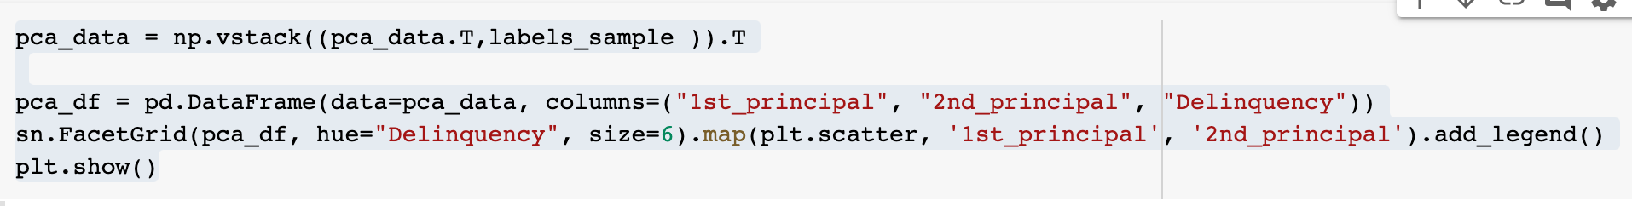
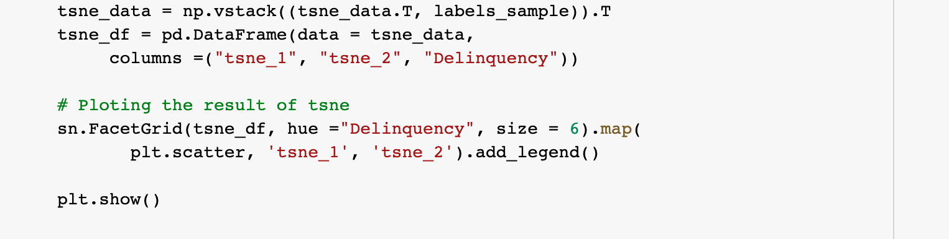
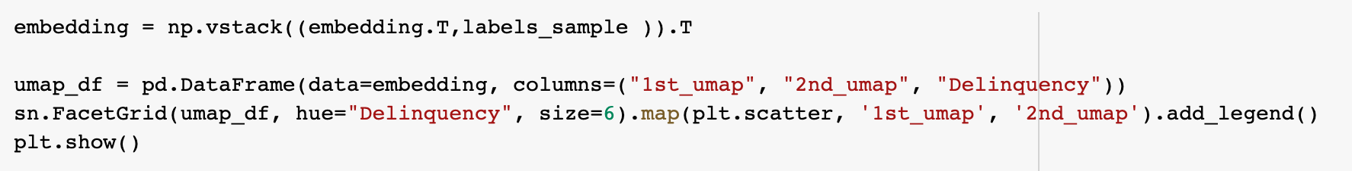
Getting the plot by FACETGRID for pca, tsne & umap to show the 20 sample

Slide 22
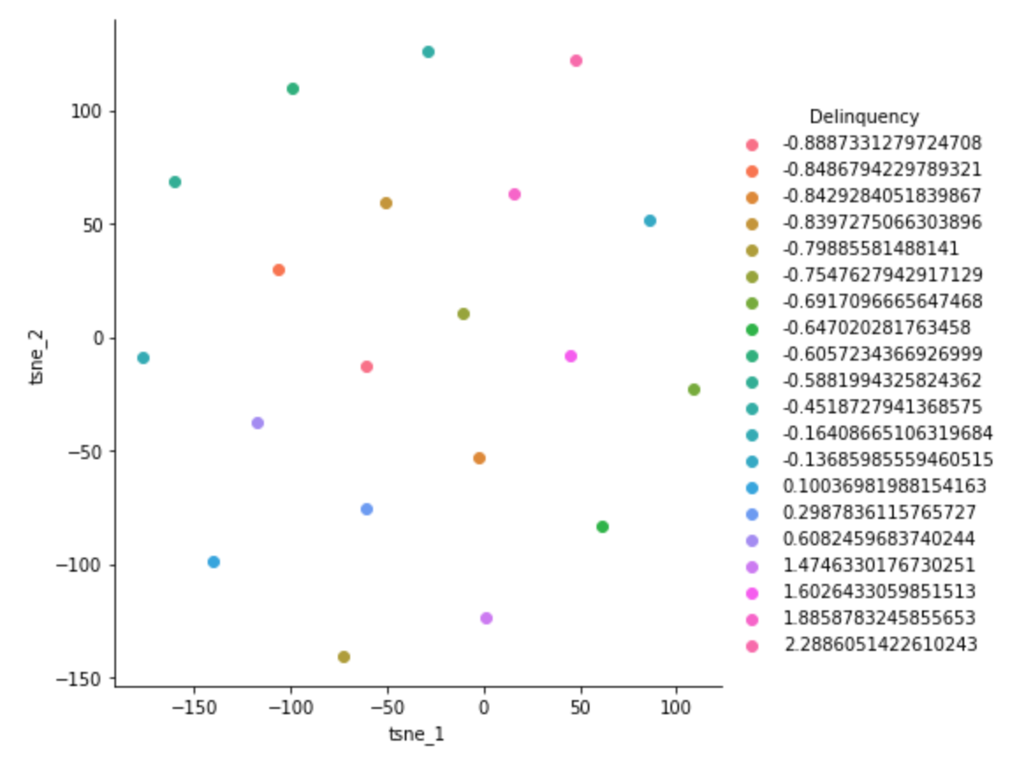
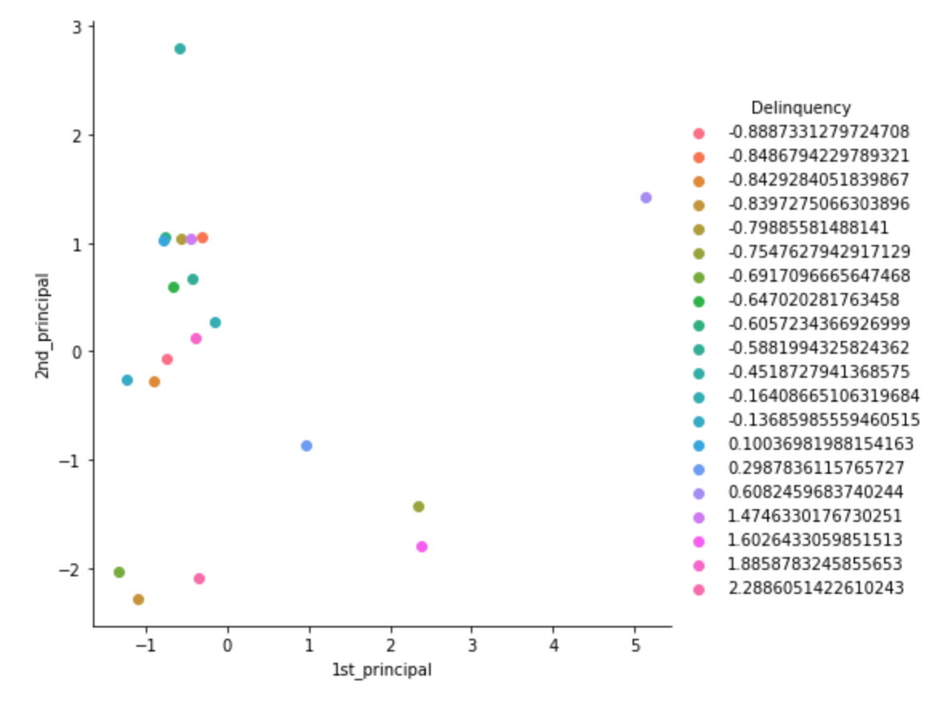
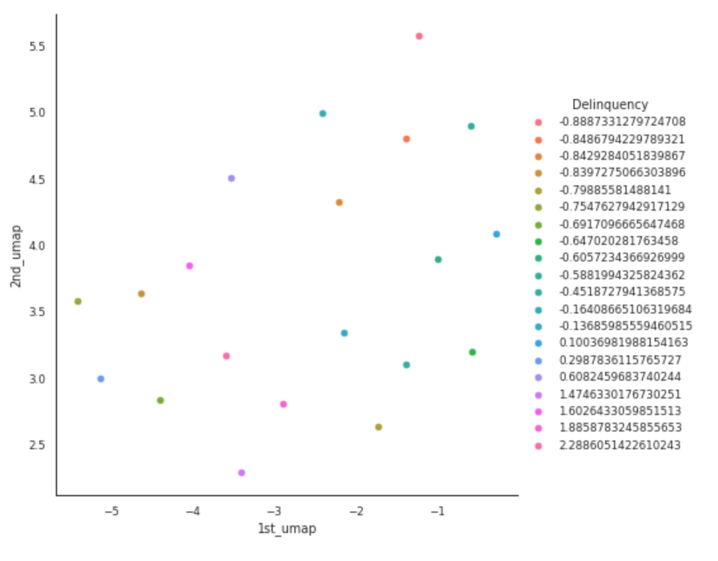
PCA CAN claims to preserve THE LOCAL structure THE BEST in the 20 SAMPLE DATA

Slide 23
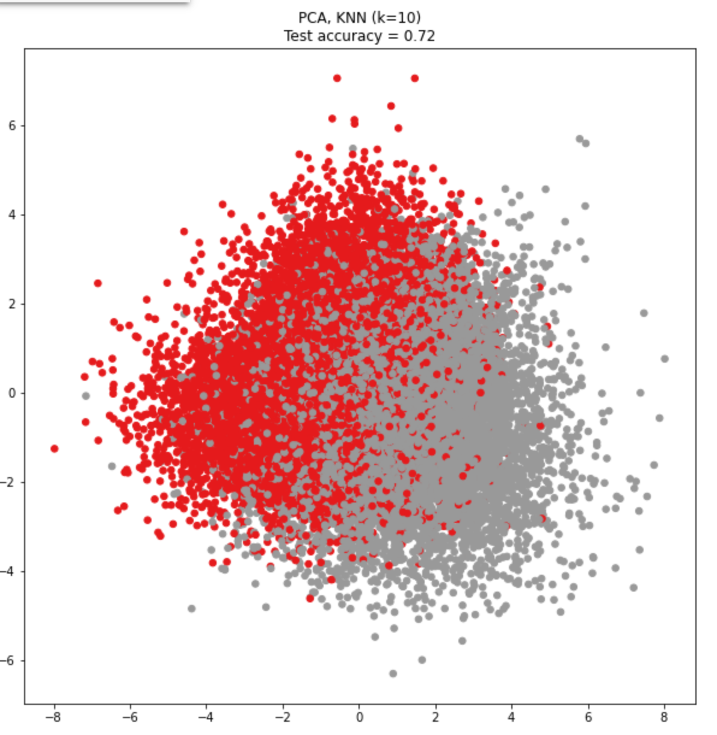
PCA WITH 10 NEIGHBORES FOR THE CREDIT_RISK_DATA DATASET

Slide 24
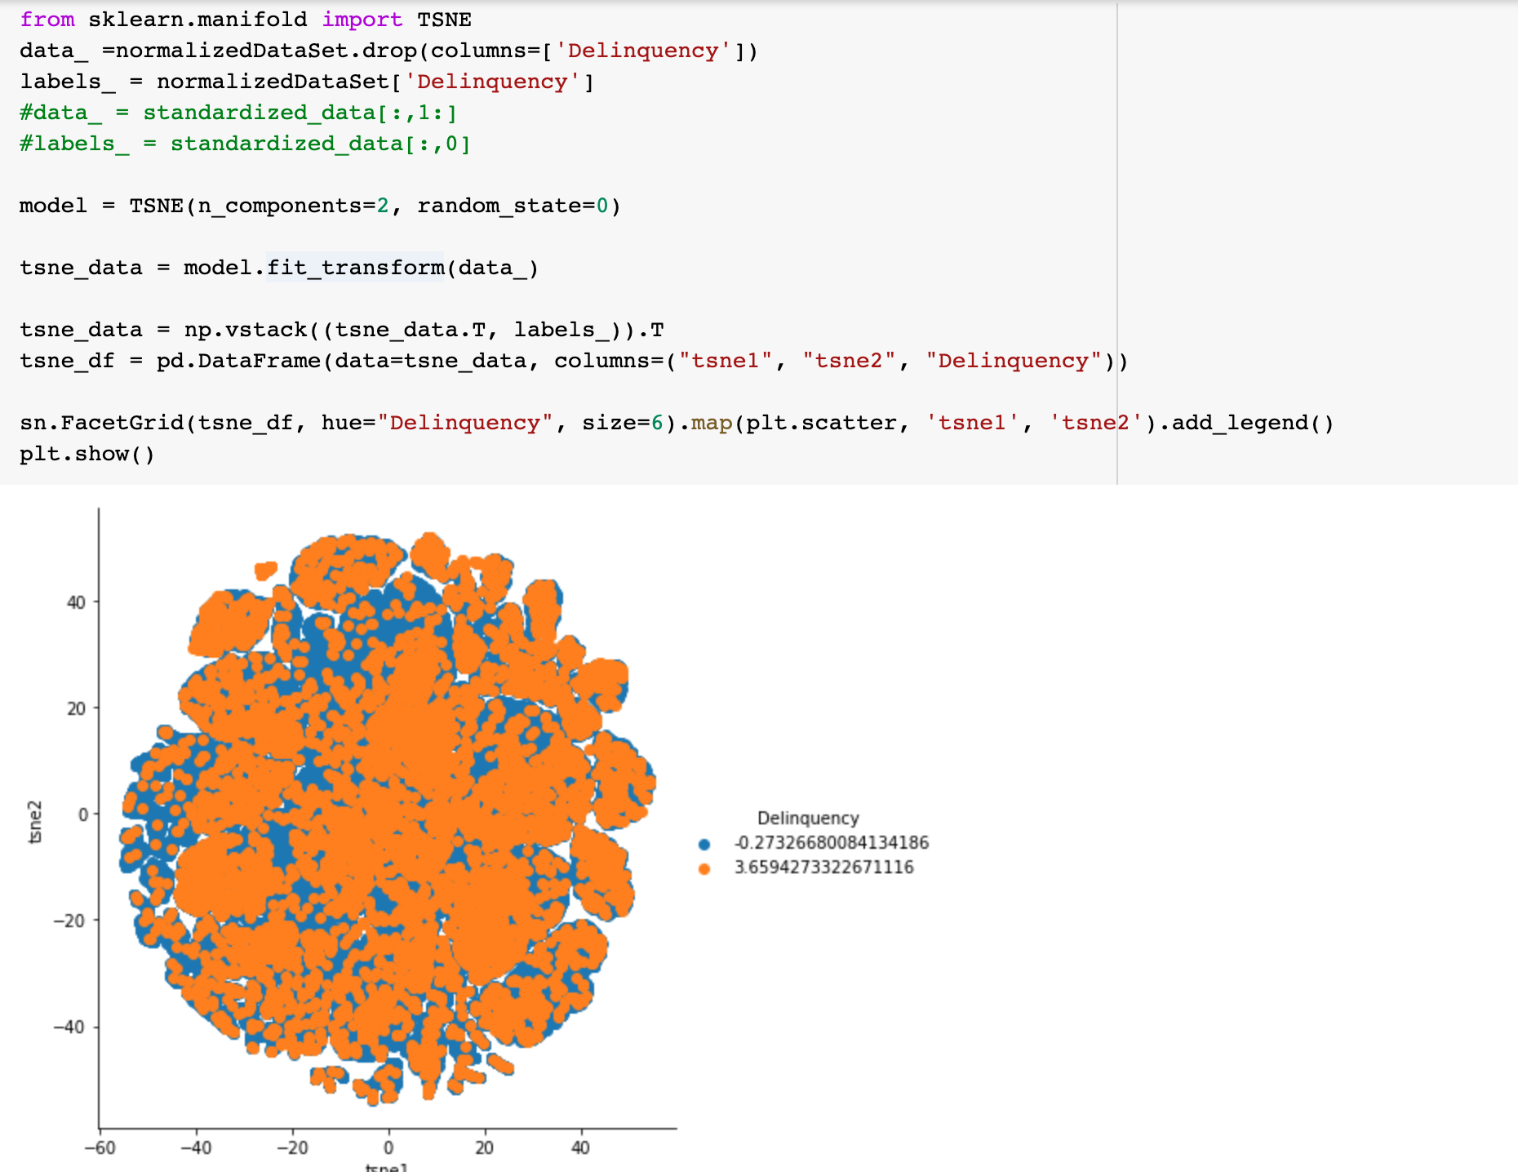
Tsne plot with facetgrid

Slide 25
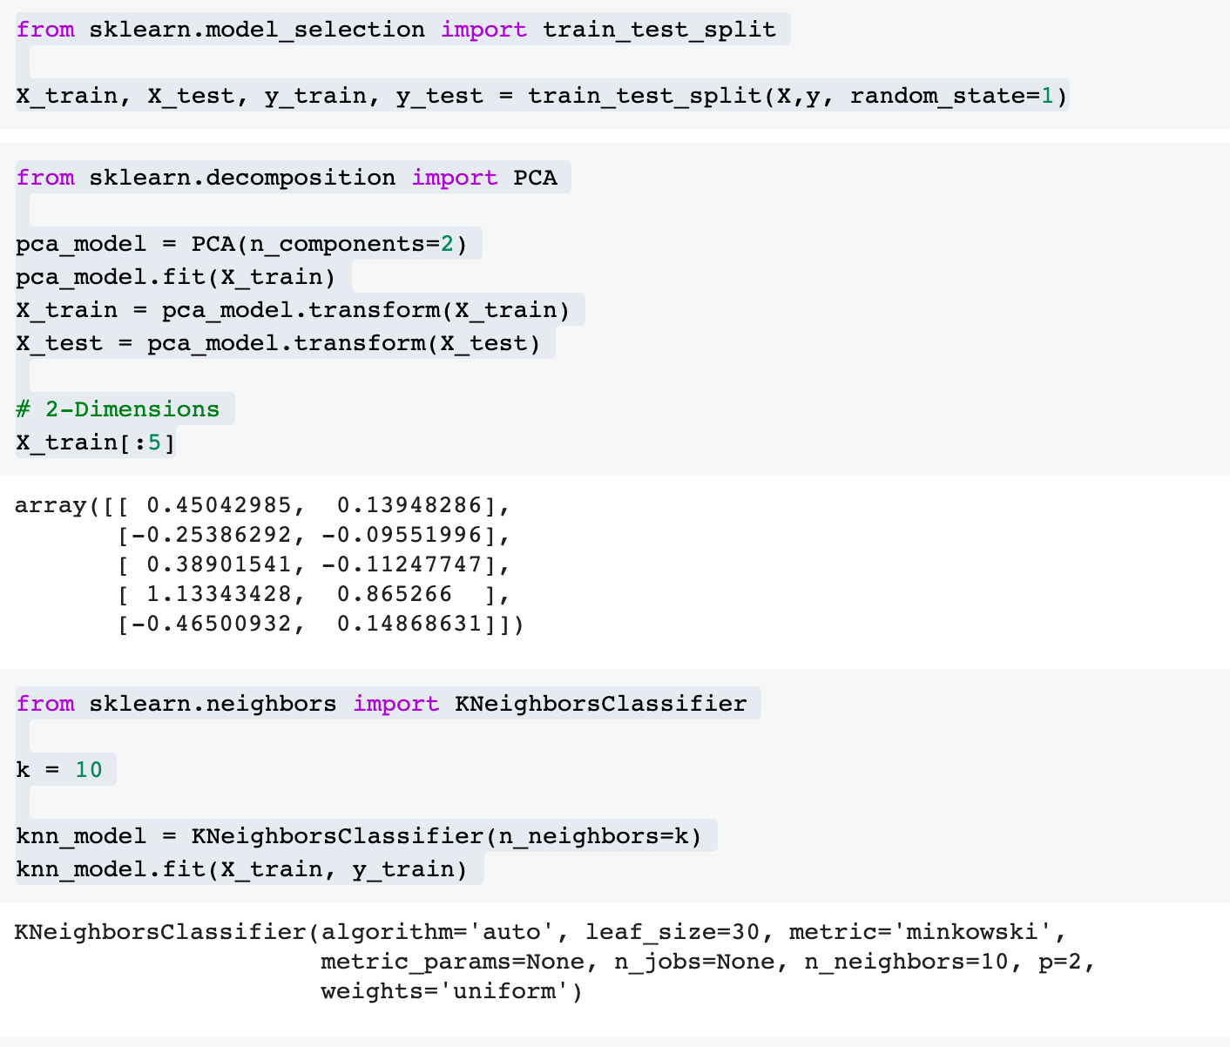
Getting knn prediction for pca

Slide 26
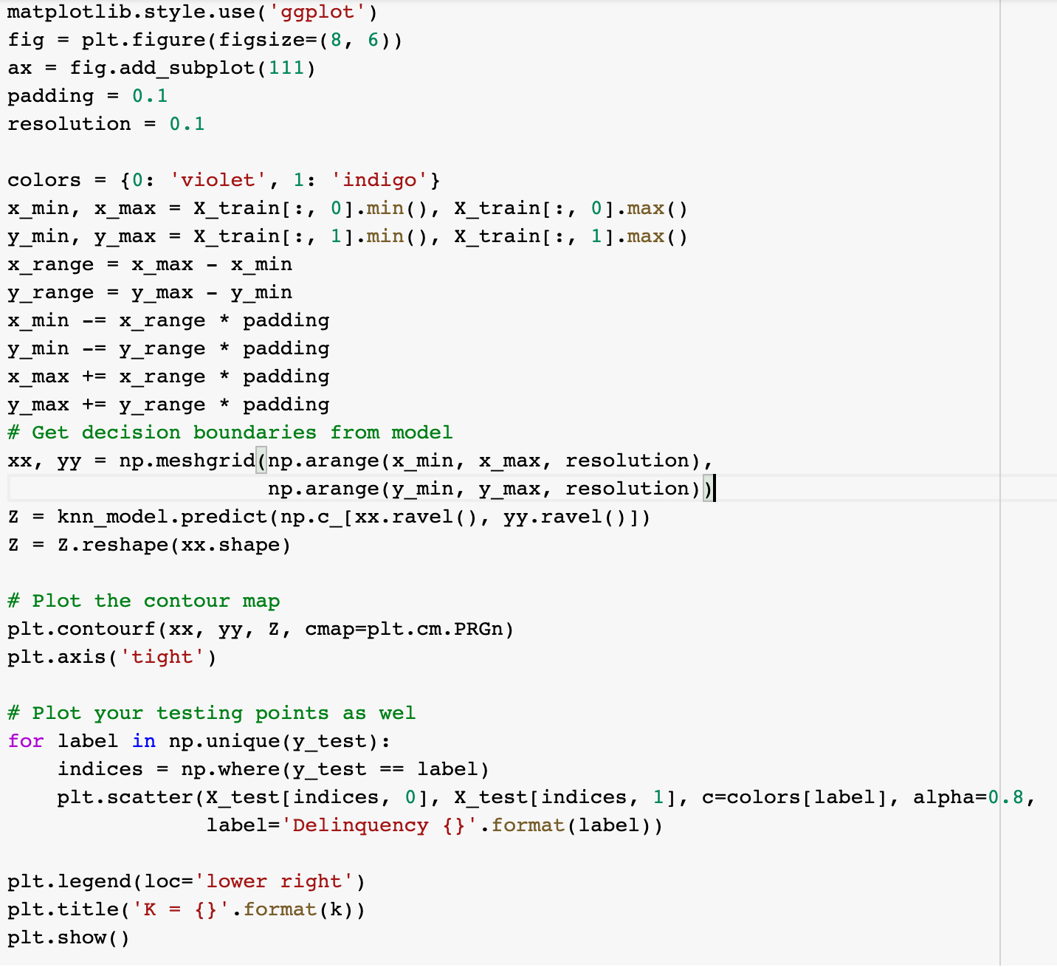
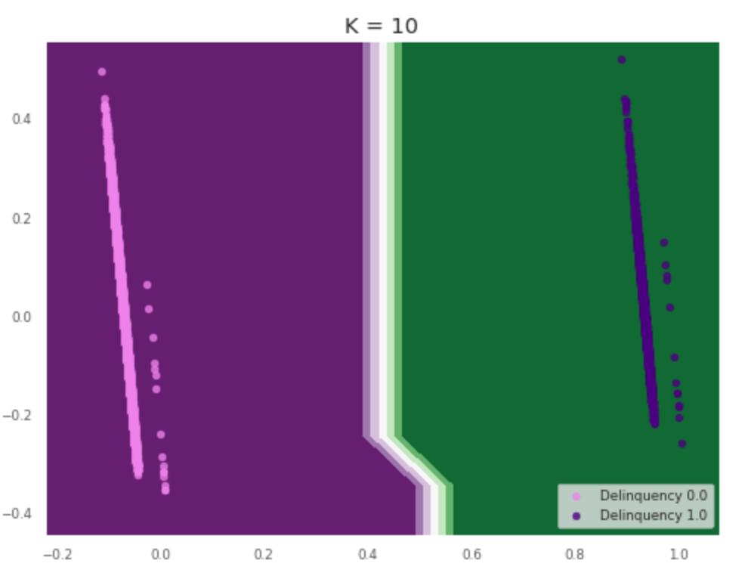
KNN PREDICT MODEL PLOT FOR pca of CREDIT_risk_data

Slide 27
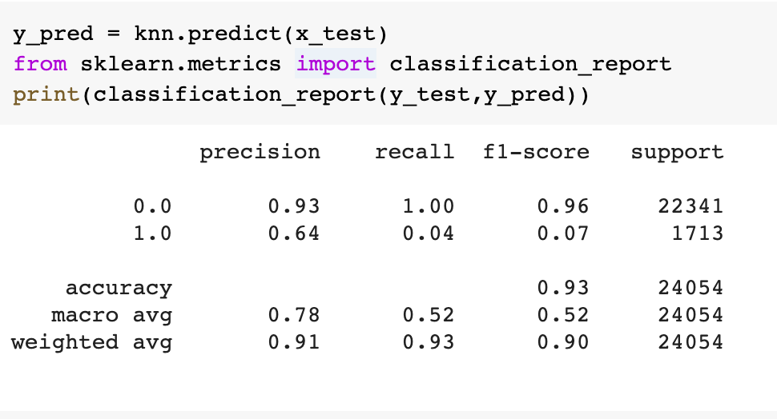
Compare your analytics results using the classification metrics and draw conclusion

Slide 28
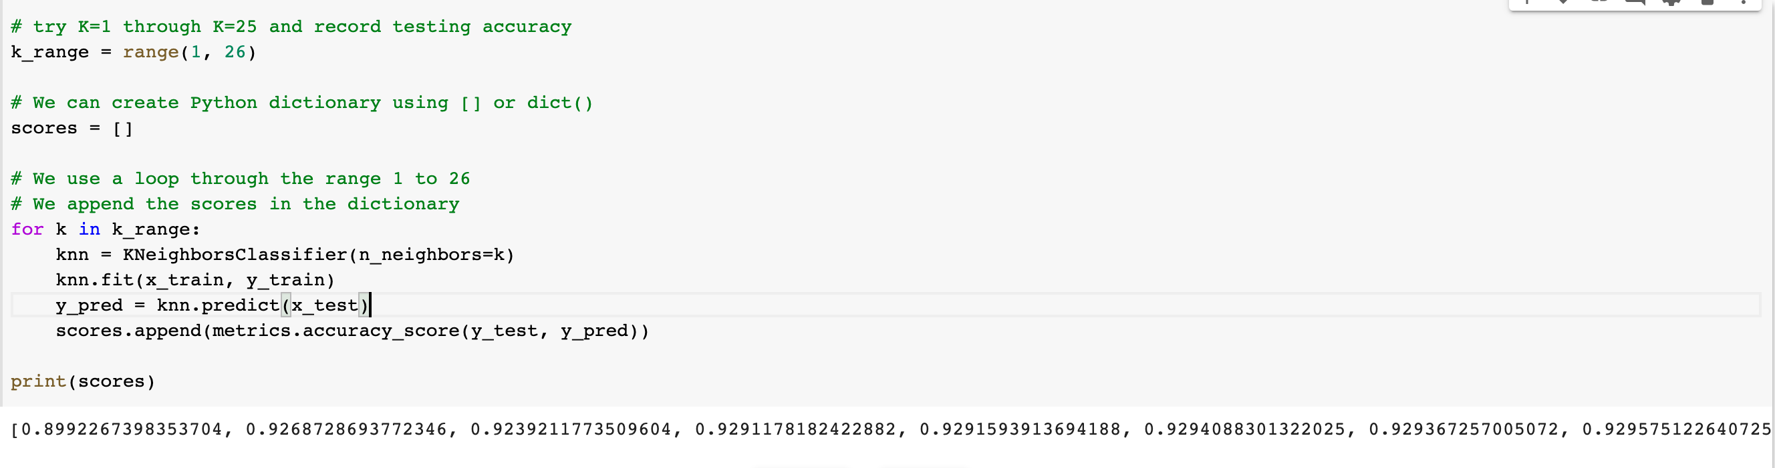
Testing accuracy for k range 1 to 26

Slide 29
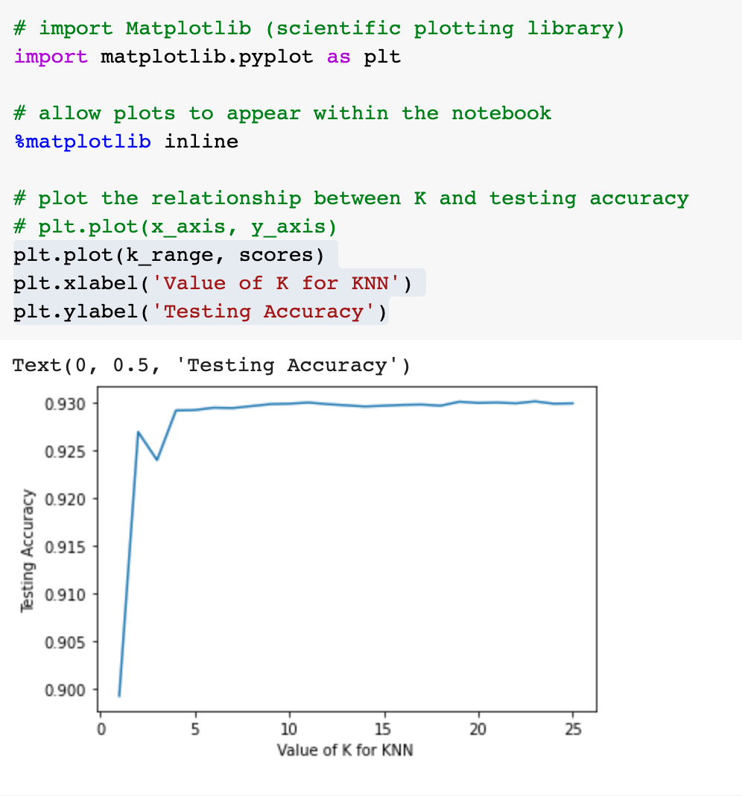
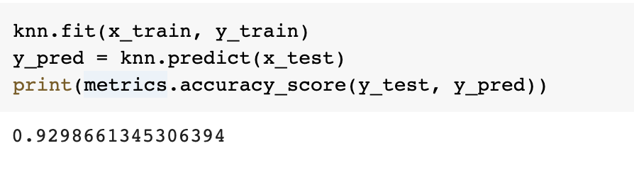
Testing Accuracy plot for k

Slide 30
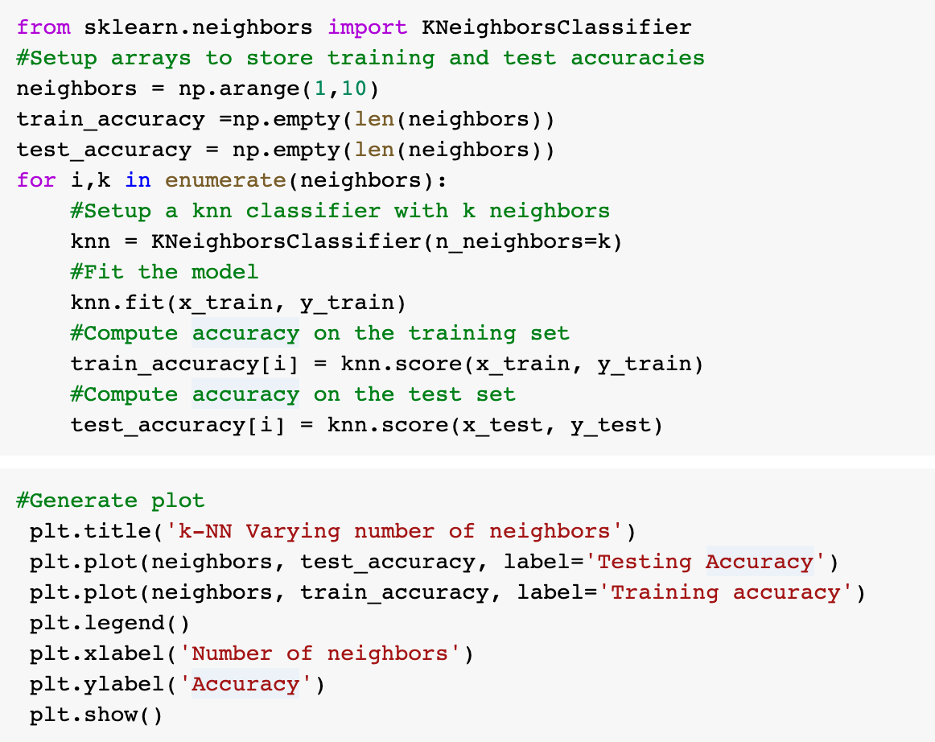
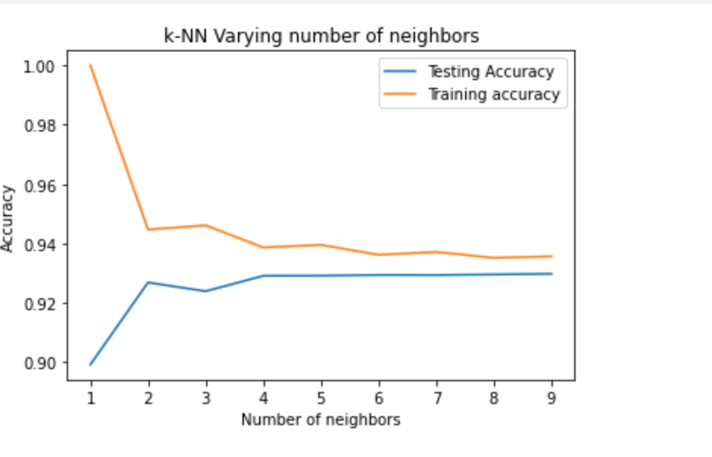
K-nn varying number of neighbor plot of
Accuracy for testing and training dataset

Slide 31
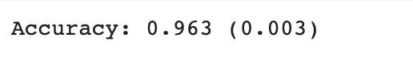
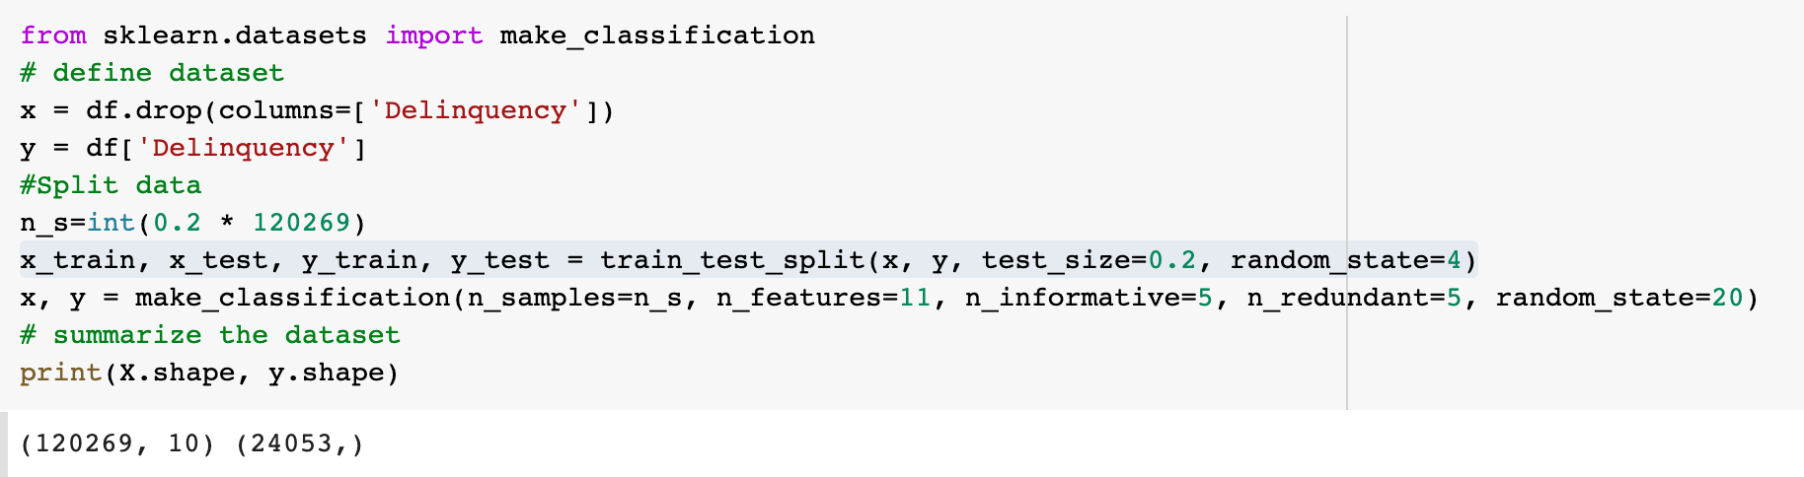
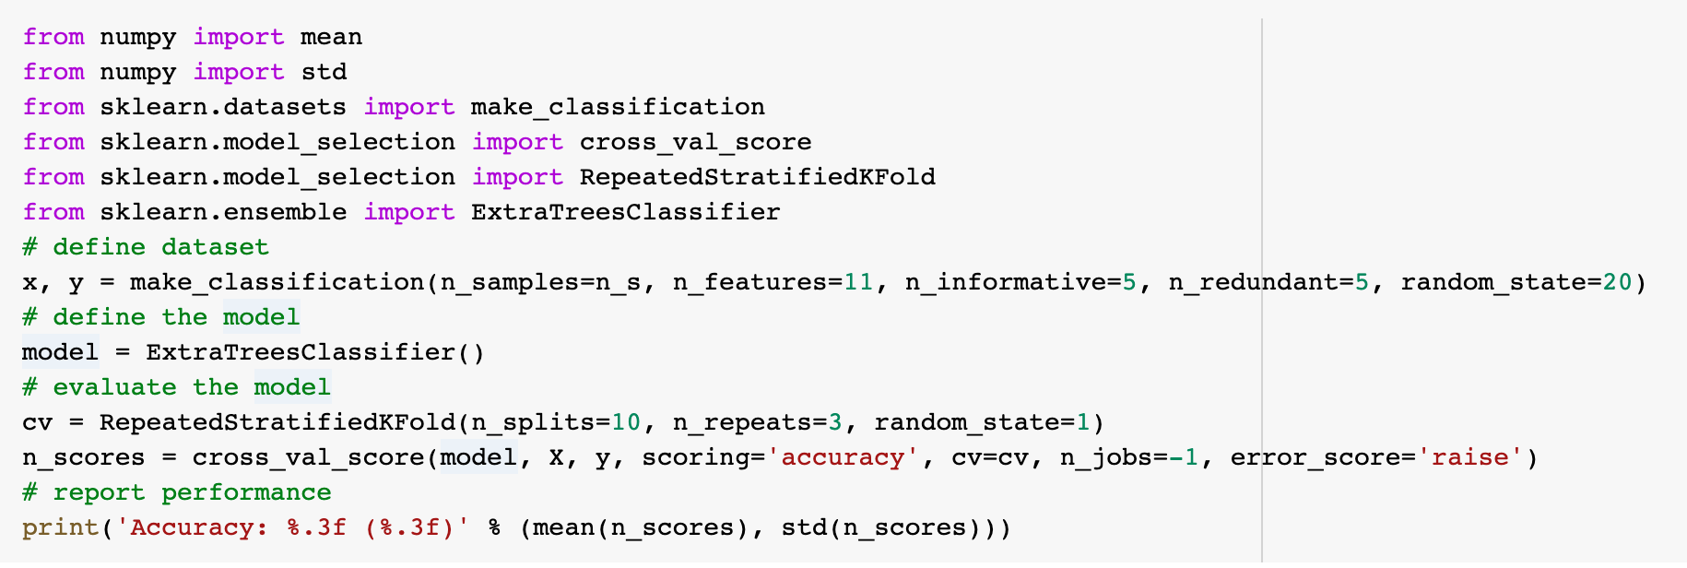
GETTING ACCURACY USING Extratreesclassification

Slide 32
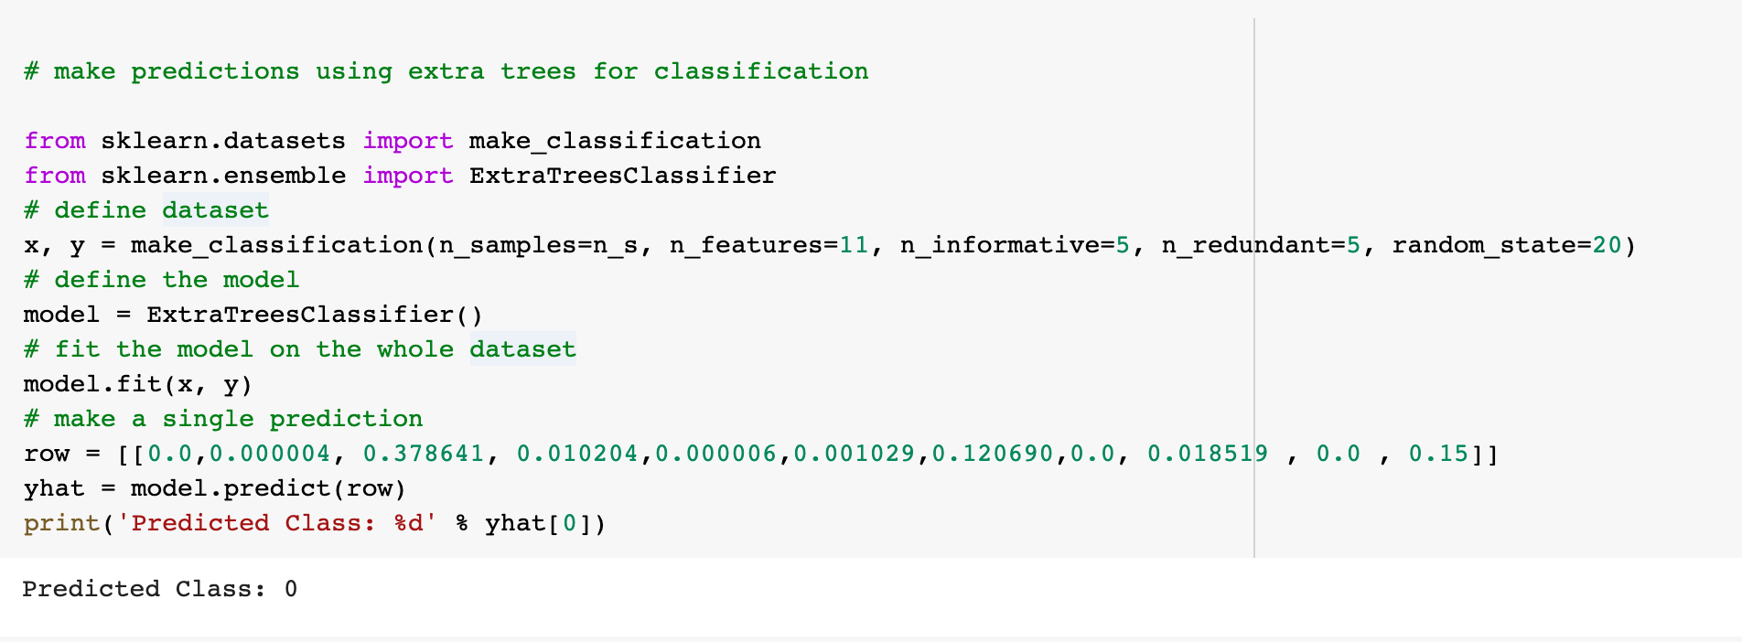
Make prediction using extra trees for classification

Slide 33
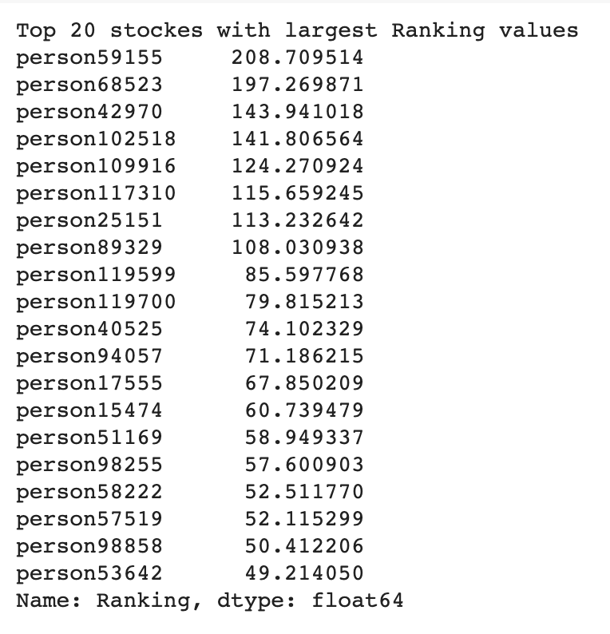
Top 20 stockes with largest pca Ranking values

Slide 34
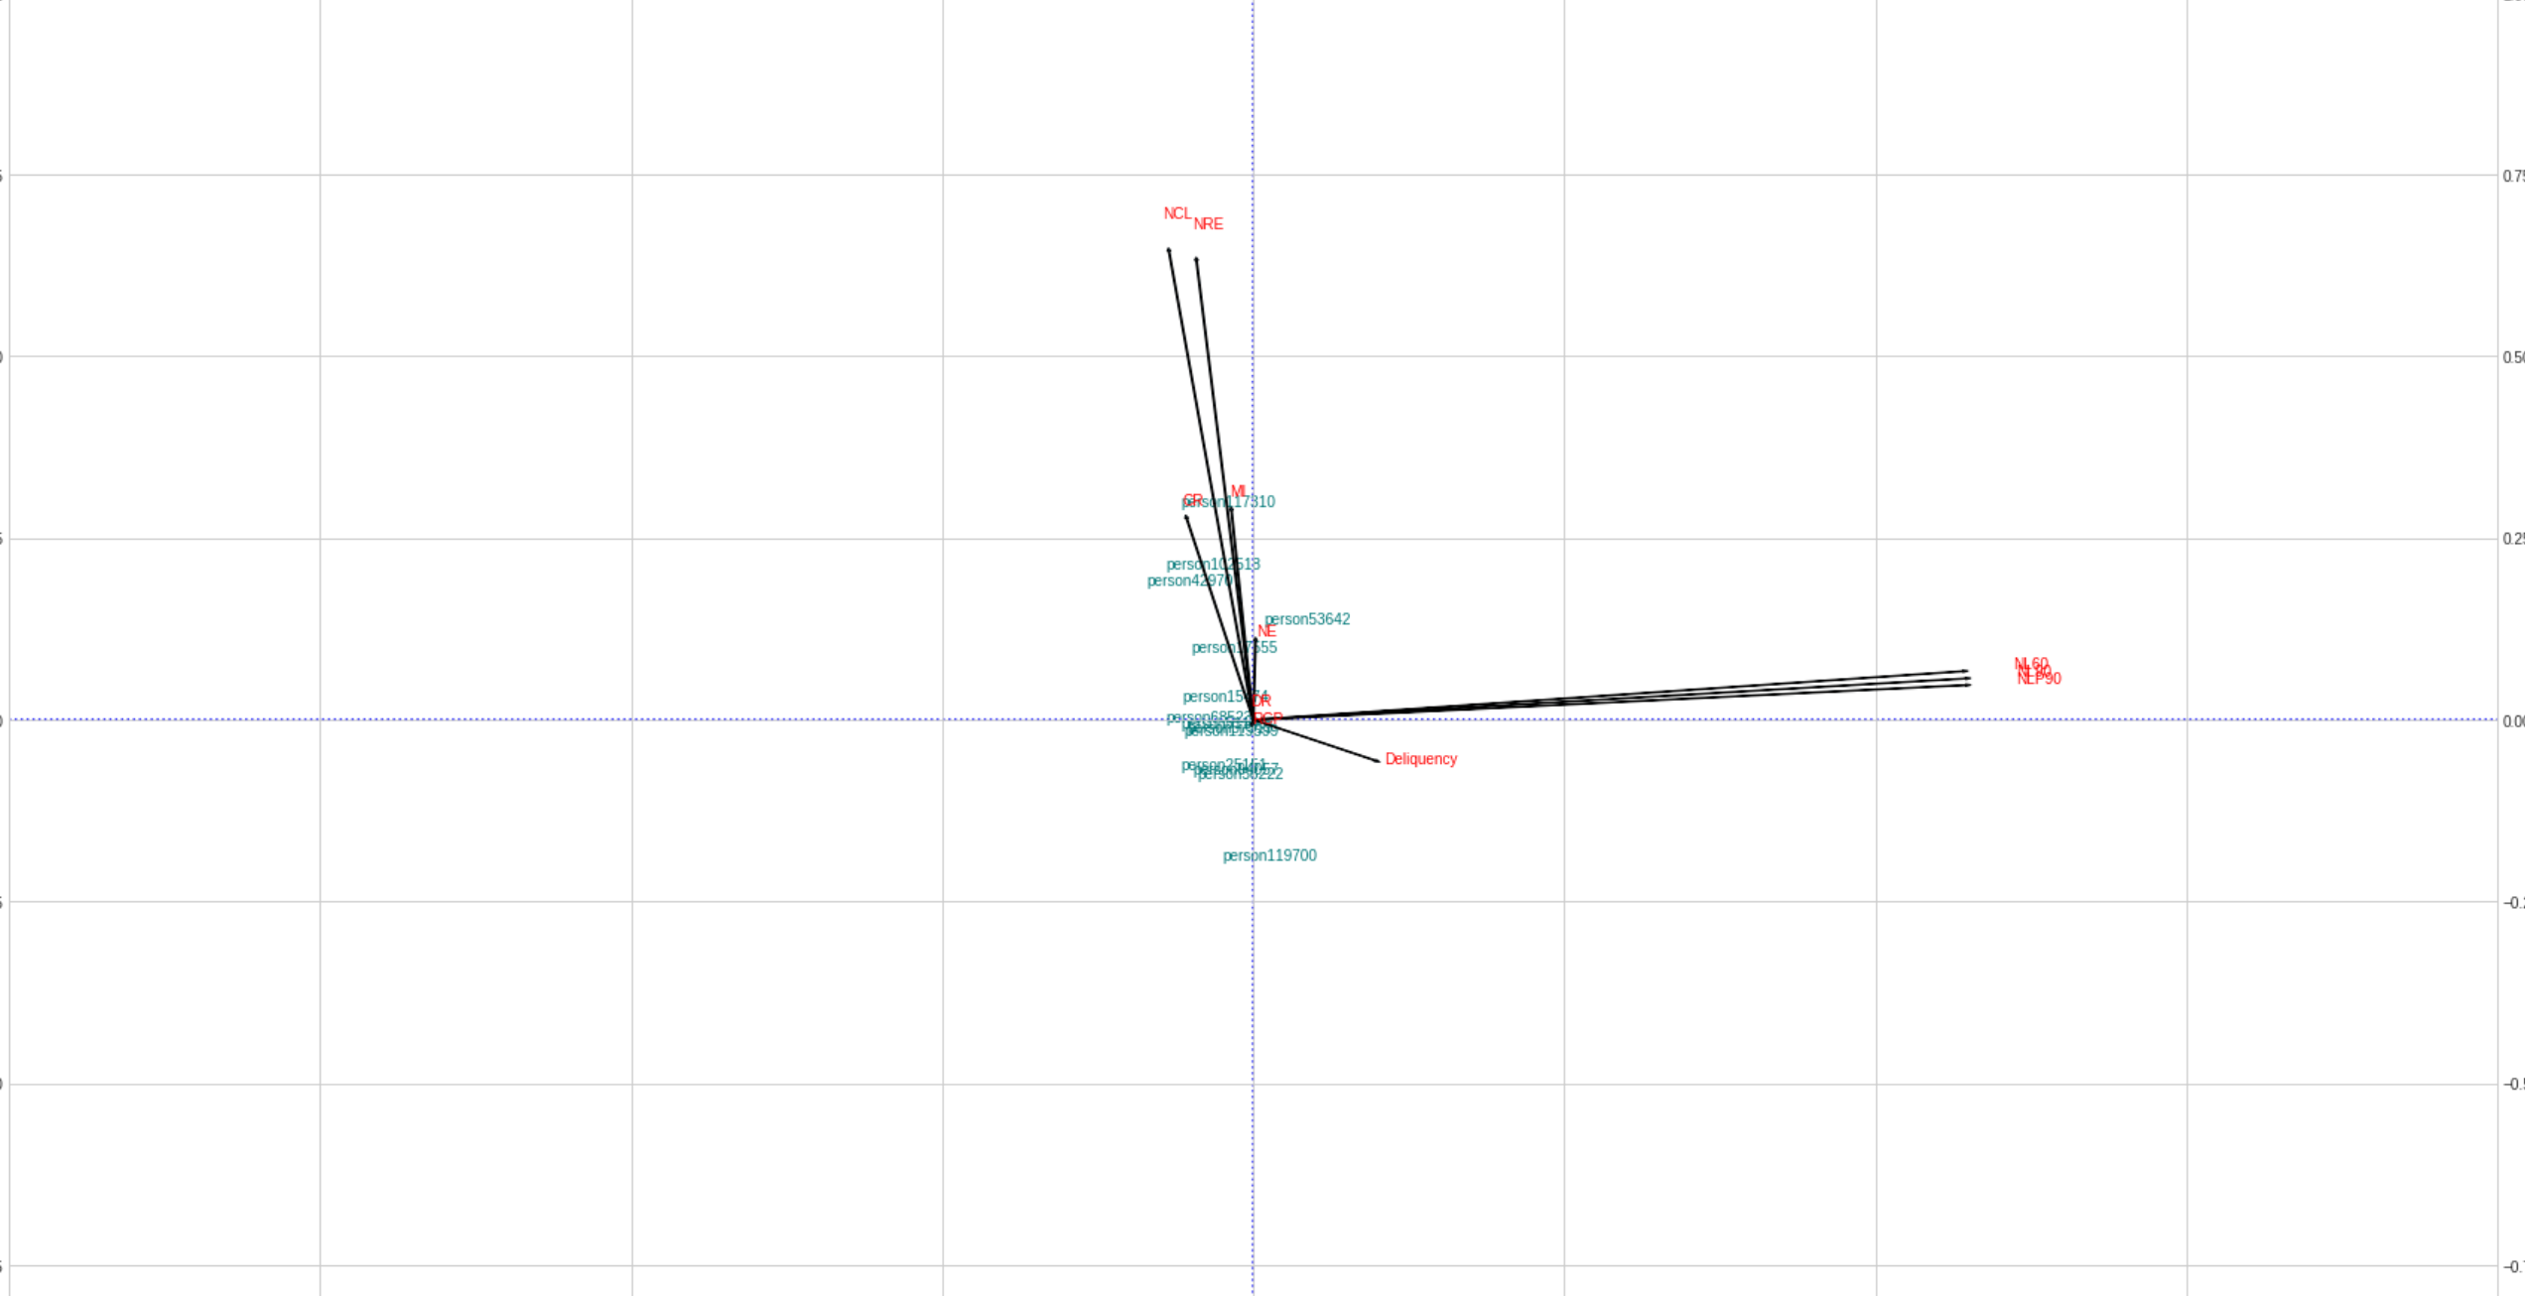
VISUALIZATION FOR Top 20 stockes with largest pca Ranking values

Slide 35
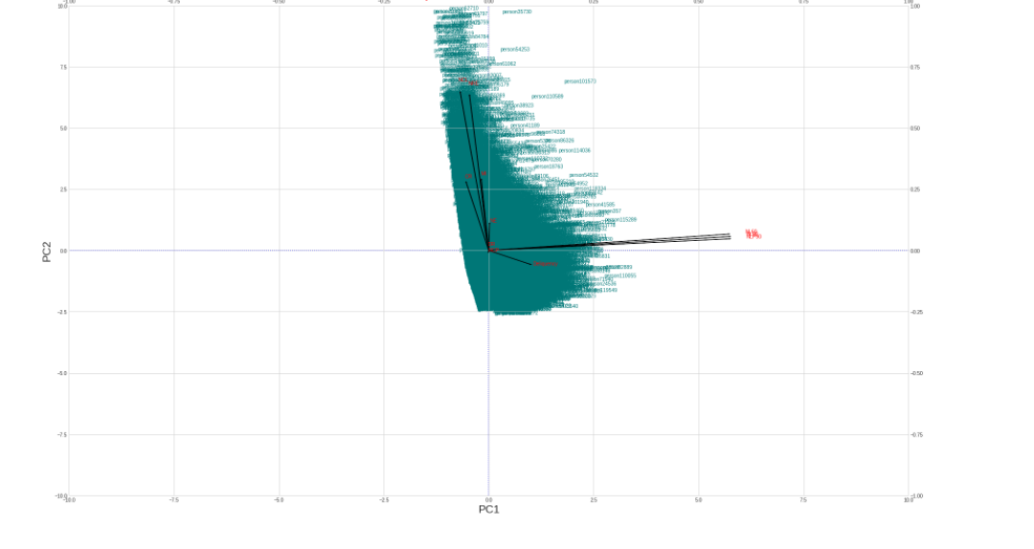
VISUALIZATION FOR THE WHOLE stockes with pca Ranking values

Slide 36
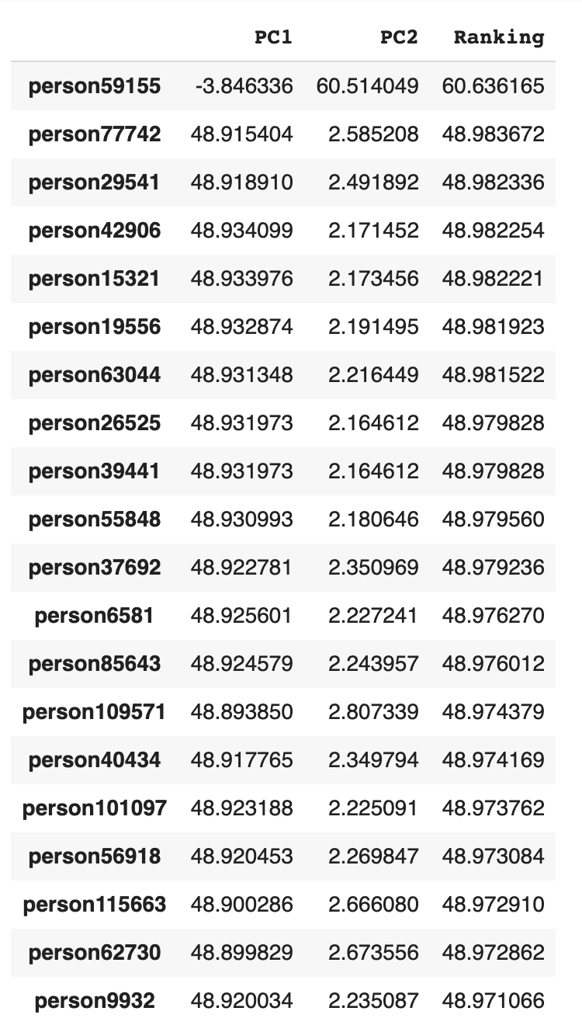
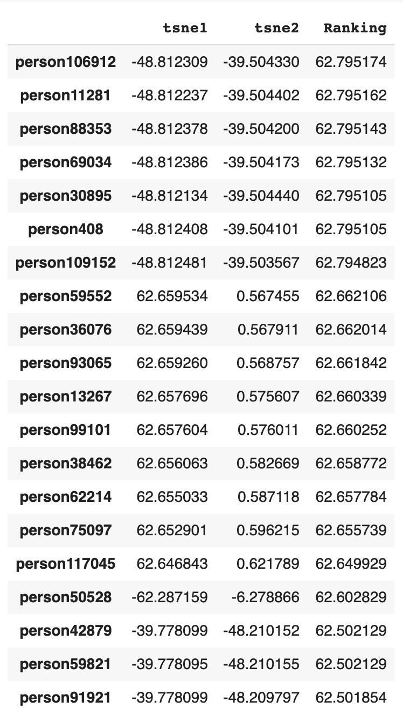

20 stockes with largest pca,TSNE &UMAP Ranking values

Slide 37



THE 20 stockes with largest pca, TSNE &UMAP Ranking values PLOTS
Umap has the most spreadness to show the data but we can see that it spreads on a same direction

Slide 38

Predicted test label under distance metric distance=['euclidean','manhattan','chebyshev','minkowski','jaccard']

Slide 39





Predicted test label under distances

Slide 40

Knn comparison for ‘MI’ & ‘ncl’ with delinquency

Slide 41



Just With k=1 we can see theboundry of region for delinquency 0 and 1

Slide 42


Knn comparison for ‘NL60’ & ‘nL90’ with delinquency
I PICKED NL60 & NL90 B/C THESE 2 FEACURES HAVE THE MOST SVA RANKING

Slide 43



WE SEE THE BOUNDRIES BETTER THAN THE LAST TRIAL

Slide 44

Design a multilayer perceptron(MLP)with at least 2 hiddenlayers(DNN),

Slide 45

We can generalize the above to access a neuron MATRIX in the following way

Slide 46


weights between input and first hidden layer
It shows how it goes to the smaller dimension!

Slide 47


Bias values for first &second hidden layer

Slide 48


populate two clusters (class0 and class1) in a two dimensional space.

Slide 49


Mlpclassifier fit

Slide 50


training a MLPClassifier for our two classes

Slide 51


Make the data set ready for cnn

Slide 52


Slide 53

Training and testing reshape

Slide 54

Building CNN model

Slide 55


Slide 56

Evaluate the model with the metrics we defined earlier

Slide 57

resampling （SMOTE-ENN） to tackle imbalanced credit_risk_clean_data

Slide 58


Reshaping resampled training and test credit_risk_clean_data
Setting up the input layer

Slide 59

CNN training

Slide 60

Accuracy, Sensitivity, specification(PPR), NPR, Diagnostic index of CNN for the Credit_risk_clean_data

Slide 61

Building the ExtraTreesClassifier model

Slide 62


Feature importance by ExtraTreesClassifier
Sorting the feature_importance as ‘extratrees’in a dataframe

Slide 63

The forward feature selection is implemented as follow:

Slide 64

Identified features

Slide 65

Add a Slide Title - 3
Comparison of different feature importance

Slide 66

Under DecisionTreeClassifier and BaggingClassifier
The accuracy of the stump = 93.0
The accuracy of ensemble=93.0

Slide 67


Under DecisionTreeClassifier and BaggingClassifier
The accuracy of the Random = 93.0
The accuracy of Extra Tree=93.0

Slide 68
sources
https://www.kaggle.com/residentmario/dimensionality-reduction-and-pca-for-fashion-mnist
https://www.kaggle.com/nickgould/monte-carlo-tutorial-calculating-pi
https://stackabuse.com/creating-a-neural-network-from-scratch-in-python/
https://scikit-learn.org/stable/modules/generated/sklearn.tree.DecisionTreeClassifier.html
https://www.analyticsvidhya.com/blog/2018/03/introduction-k-neighbours-algorithm-clustering/
https://www.kaggle.com/pratsiuk/valueerror-unknown-label-type-continuous
https://towardsdatascience.com/
https://towardsdatascience.com/complete-guide-to-data-visualization-with-python-2dd74df12b5e
https://machinelearningmastery.com/tutorial-to-implement-k-nearest-neighbors-in-python-from-scratch/

Slide 69
Thank you for your great classes!

